Slide 1
Qatar world cup
Is this a positive sporting event?

Slide 2
Inspiring today’s children for tomorrow’s world
What do we value at Elburton?

Slide 3
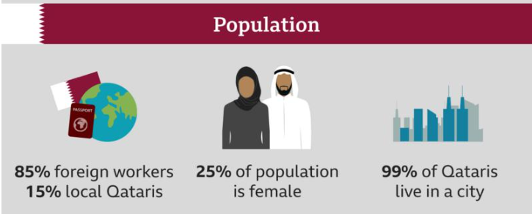
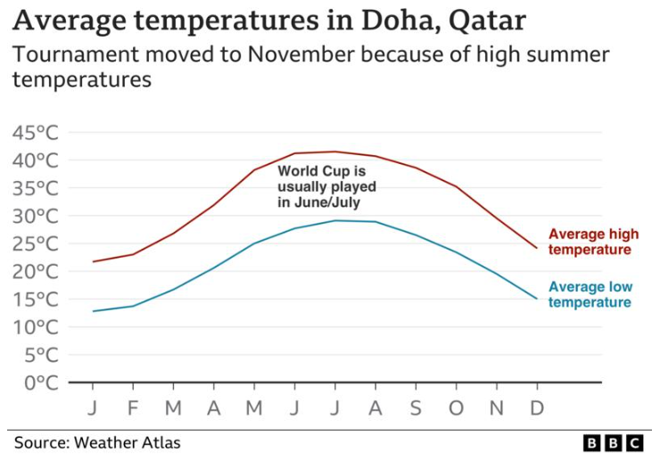
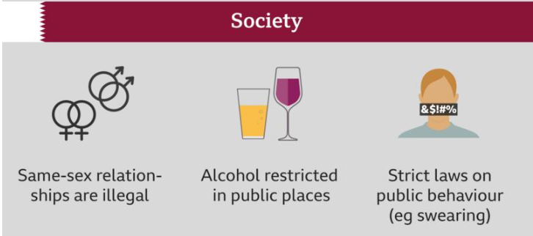
How does Qatar differ to Elburton?

Slide 4
The Equality Act 2010
The Equality Act came into force on 1st October 2010. It brings together over 116 separate pieces of legislation into a single act.
The Equality Act 2010 lays out a legal framework to protect the rights of individuals and advance equality of opportunity for all. It provides Britain with a discrimination law that prevents individuals from facing unfair treatment.

Slide 5
The Equality Act 2010
Under the Equality Act 2010, you are protected from discrimination:
when you are in the workplace,
when you use public services like healthcare (for example, visiting your doctor or local hospital) or education (for example, at your school or college),
when you use businesses and other organisations that provide services and goods (like shops, restaurants, and cinemas),
when you use transport,
when you join a club or association (for example, your local tennis club),
when you have contact with public bodies like your local council or government departments.

Slide 6
What Is Discrimination?
Discrimination is the unfair or prejudicial treatment of people and groups based on protected characteristics. It often stems from negative stereotypes. For example, stereotypes about sex and gender can lead to sexism, and stereotypes about race can lead to racism. Acts of discrimination may include bullying.
Prejudice is the judgement of someone or something without knowing enough information about that person or thing.
A hate crime is any criminal offence that is perceived to be motivated by prejudice based on disability, race, religion, sexual orientation or transgender identity.
It is important for us to be informed about these issues, because both students and teachers may experience discrimination in schools. For example, data shows that UK schools have recorded more than 60 000 racist incidents in the past five years,¹ but real figures are believed to be much higher.
¹ UK Schools Record More than 60,000 Racist Incidents in Five Years (The Guardian)

Slide 7
How Can You Be Discriminated Against?
There are four main types of discrimination:
Direct Discrimination
Treating one person differently or worse than another person because of a protected characteristic.
Harassment
Treating someone in a way that violates their dignity or creates a hostile, degrading, humiliating or offensive environment.
Victimisation
Treating someone unfairly because they are taking action against someone under the Equality Act (like making a complaint about discrimination)
Indirect Discrimination
This can happen when an organisation implements a rule, policy or way of doing things that has a worse impact on people with a particular protected characteristic.

Slide 8
Disability
The Equality Act 2010 protects people against discrimination based on any disabilities that they may have.
This includes any long-term physical or mental health conditions that impact a person’s ability to carry out day-to-day activities.
Discrimination against people based on disability is referred to as ableism. It is typically based on irrational hatred, intolerance and fear of people with disabilities.

Slide 9
Invisible Disabilities
Invisible disabilities (or hidden disabilities) are disabilities that are not visible from the outside. The term ‘invisible disability’ exists as an umbrella term that captures a whole spectrum of hidden disabilities, chronic medical conditions and other challenges.
Other people may struggle to recognise an invisible disability because they cannot see physical evidence of it. As a result, people with invisible disabilities can sometimes find it difficult to access the support they need as their disability is not always understood by others.

Slide 10
Invisible Disabilities
Invisible disabilities (or hidden disabilities) are disabilities that are not visible from the outside. The term ‘invisible disability’ exists as an umbrella term that captures a whole spectrum of hidden disabilities, chronic medical conditions and other challenges.
Other people may struggle to recognise an invisible disability because they cannot see physical evidence of it. As a result, people with invisible disabilities can sometimes find it difficult to access the support they need as their disability is not always understood by others.
What examples of invisible disabilities can you think of?
Illness
Autism/ASC
Visual impairments
Hearing loss
Learning difficulties
Breathing problems

Slide 11
Race
The Equality Act 2010 protects people against discrimination based on their race.
Prejudice and discrimination against people based on the colour of their skin or the racial or ethnic group to which they belong is referred to as racism. It takes many forms and can happen in many places, but is typically targeted at minority groups.
Xenophobia refers specifically to the discrimination or prejudice against people from different countries.
Racially motivated hate crimes are the most common type of hate crime reported in the UK. There were over 85 000 racially motivated offences recorded in 2020/2021.²
² Racism in the UK (Stop Hate UK)

Slide 13
Religion or Belief
The Equality Act 2010 protects people against discrimination based on their religion or beliefs.
³ University of Birmingham Survey Reveals Islamophobia Is the Posh Person’s Prejudice (University of Birmingham)

Slide 14
Sex
The Equality Act 2010 protects people against discrimination based on their biological gender.
Prejudice and discrimination against people based on sex or gender is referred to as sexism.
Although gender equality has come a long way in the last century, there are still many areas where sexism is commonplace.
The gender pay gap refers to the difference in pay between men and women in employment. A gender pay gap still exists despite there being laws in the UK that call for equal pay.
⁴ Women’s Health Outcomes: Is There a Gender Gap? (House of Lords Library)

Slide 16
Sexual Orientation
The Equality Act 2010 protects people against discrimination based on their sexual orientation.
Homophobia is an umbrella term for prejudice and discrimination against people who are in same sex relationships
Statistics show that 21% of LGBT people have experienced a hate crime or incident due to their sexual orientation and/or gender identity in the last year. ⁵
36% of LGBT people say that they do not feel comfortable walking down the street holding their partner’s hand. This increases to 58% for gay men.
⁵ LGBT in Britain - Hate Crime and Discrimination (Stonewall)

Slide 17
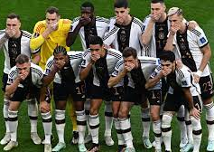
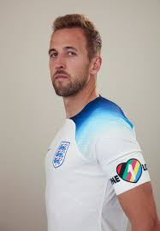

Slide 18
Marriage and Civil Partnership
The Equality Act 2010 protects people against discrimination because they are married or in a civil partnership.
It protects people with a formal legal partnership with someone either of the same sex or opposite sex.

Slide 19
Gender Reassignment
The Equality Act 2010 protects people against discrimination based on gender reassignment.
Transphobia is prejudice and discrimination against people who identify as or are perceived to be transgender. It is typically based on irrational hatred, intolerance and fear.
A person whose gender identity does not align with the sex they were registered with at birth may identify as transgender or trans.
Statistics show that 25% of trans people have experienced homelessness at some point in their life, and that 41% have experienced a hate crime or incident because of their gender identity in the last year.⁶
⁶ LGBT in Britain – Trans Report (Stonewall)

Slide 20
Age
The Equality Act 2010 protects people against discrimination based on their age.
Discrimination against people based on their age can be referred to as ageism.

Slide 21
How Can We Learn From This?
Always show respect for others in your words and actions
Never joke, ‘banter’ or make fun of people for being different
‘It was only a joke’ will never be an excuse
If you feel like you have been treated unfairly due to a protected characteristic, speak out. You will always be listened to
Be proud to be different!

Slide 22
IT’S GOOD TO BE ME!
From Songs for every Happy, Healthy School
Track 2
1)It’s good to be me,
It’s good to know you,
It’s great to be different but together.
There’s no need to be
In anyone’s shoes,
I’m happy to be the ‘me’ I am!
(Repeat)
Chorus
But if I try to compare myself with you
And all the things you do,
I’ll never see all the qualities
That make me the ‘me’ I am!
(Repeat)
`
2)It’s good to be me,
Whatever I do,
I’m free to be who I am
wherever.
With all of my faults
(And there’ll be a few!)
I’m happy to be the ‘me’
I am!
Chorus
Chorus with verse 1
Chorus with verse 2
Repeat verse 2

