Slide 1
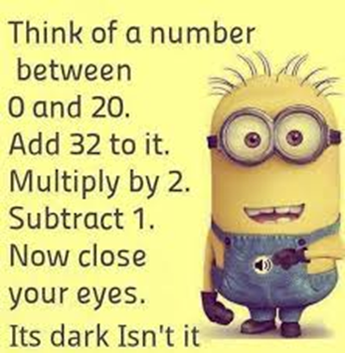



Slide 2

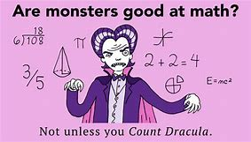
Helping my child with
Maths in Key Stage 2
Elburton Primary School
“Life is a math equation. In order to gain the most, you have to know how to convert negatives into positives.”
Notes:
SJ

Slide 3
Aims of meeting
To gain an insight into how Maths is taught at Elburton Primary.
To gain an understanding of the National Maths curriculum and expectations of Key stage 2.
To take part in a variety of Maths activities with our Mathemagicians! – DON’T PANIC!
To take away some ideas to support your children at home and develop an understanding of what a growth mindset is.
Notes:
SJ

Slide 4
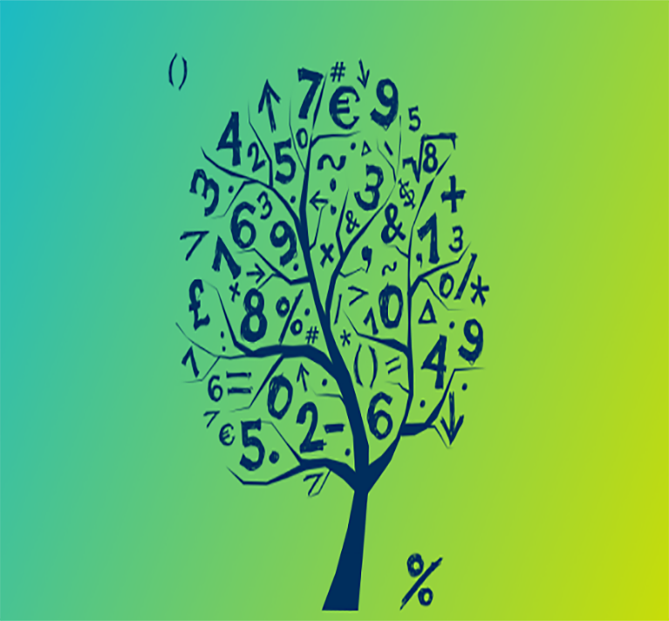
Before we start…
Be positive about maths. Don't say things like "I can’t do maths" or "I hated maths at school"; your child might start to think like that themselves. How many times have you heard someone say “Mum is the English person, Dad does the Maths!”
Point out the maths in everyday life. Include your child in activities involving maths such as using money, cooking and travelling.
Praise your child for effort rather than talent - this shows them that by working hard they can always improve.
TOP TIPS!

Slide 5
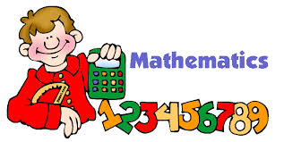


Thinking is at the heart of Mathematics and therefore should be at the heart of Mathematical teaching and learning.
At Elburton Primary, we believe that all children can do Maths (and do it well)
Increased engagement can lead to a 30% improvement in attainment!
https://www.youtube.com/watch?v=sLPFaOvhlKw
Notes:
SJ

Slide 6
Warm Up
How many dots?
How did you see them?
Notes:
SJ – thumbs up when you know how many dots there are, NO SHOUTING out.
Finger is you can see the dots in another way – share
Subitising – automatic recognition (latin) without counting.

Slide 9
Notes:
SJ – thumbs up when you know how many dots there are, NO SHOUTING out.
Finger is you can see the dots in another way – share
Subitising – automatic recognition (latin) without counting.

Slide 11
The National Curriculum
The National Curriculum states that children should:
Become fluent in the fundamentals of mathematics, including through varied and frequent practice with increasingly complex problems over time, so that pupils develop conceptual understanding and the ability to recall and apply knowledge rapidly and accurately.
Reason mathematically by following a line of enquiry, conjecturing relationships and generalisations and developing an argument, justification or proof using mathematical language.
Solve problems by applying their mathematics to a variety of problems with increasing sophistication, including breaking down problems into a series of simpler steps and persevering in seeking solutions.
Notes:
MC - 2015 – New Maths Curriculum – called Mastery curriculum. This means that teachers should focus on key concepts and not move on until all children have mastered that particular area. Within Maths there are three main elements that inter-weave.
Fluent –
Reasoning –
Problem solving

Slide 12
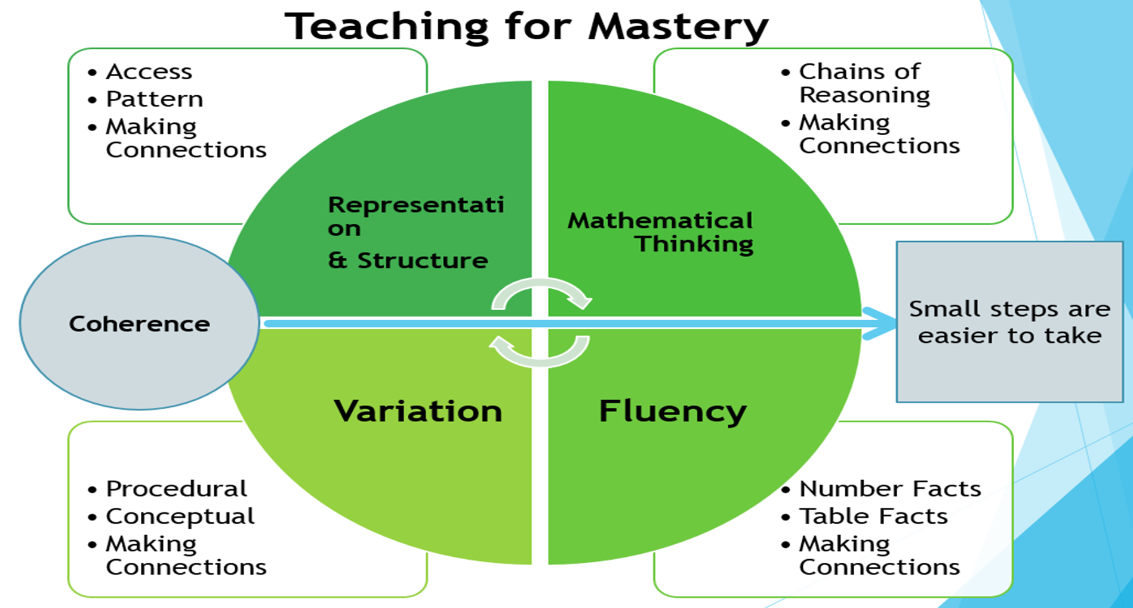

Slide 13
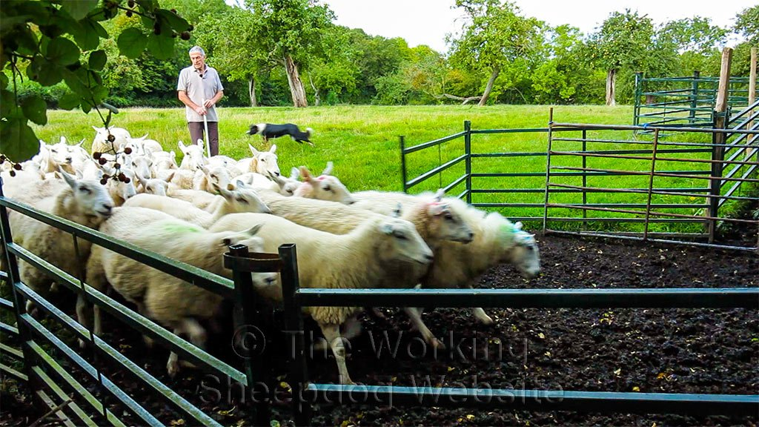
Maths?

Slide 14
Key elements of a Mastery Curriculum in Maths
Whole Class Moves Through Content At The Same Pace
When teaching maths for mastery, the whole class moves through topics at broadly the same pace. Each topic is studied in depth and the teacher does not move to the next stage until all children demonstrate that they have a secure understanding of mathematical concepts.

Slide 15
Key elements of a Mastery Curriculum in Maths
Builds Self-Confidence In Learners
In a traditional primary school maths lesson, children are put in different groups and given different content based on their anticipated ability.
This means that from an early age children are classed as those who can and can’t “do maths”.
This inclusive approach, and its emphasis on promoting multiple methods of solving a problem, builds self-confidence and resilience in pupils.

Slide 16
Key elements of a Mastery Curriculum in Maths
Differentiates Through Depth Rather Than Acceleration
Though the whole class goes through the same content at the same pace, there is still plenty of opportunity for differentiation.
Unlike the old model, where advanced learners are accelerated through new content, those pupils who grasp concepts quickly are challenged with rich and sophisticated problems within the topic.
Those children who are not sufficiently fluent are provided additional support to consolidate their understanding before moving on.

Slide 17
Key elements of a Mastery Curriculum in Maths
Time To Think Deeply About The Maths
Students are given time to think deeply about the maths and really understand concepts at a relational level rather than as a set of rules or procedures.
This slower pace leads to greater progress because it ensures that students are secure in their understanding and teachers don’t need to revisit topics once they’ve been covered in depth.

Slide 18
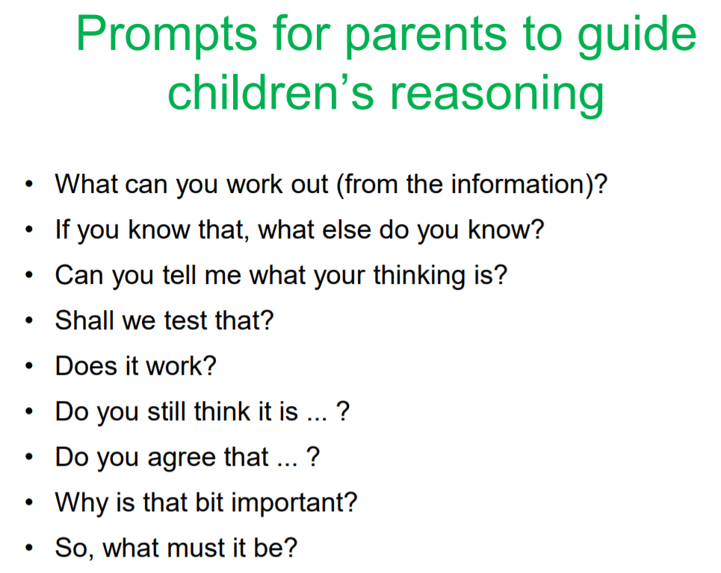

Slide 19
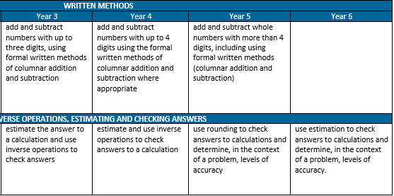
Progression across the school has been agreed bearing in mind the National curriculum as well as a scheme produced by the White Rose Maths Hub.
The progression of skills can be found on the Elburton School website.
Notes:
SJ

Slide 20
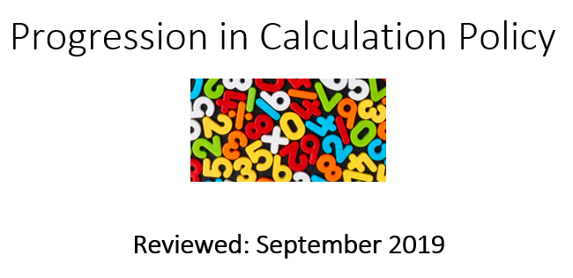
The Calculation Policy can also be found on the website for your reference.

Slide 21
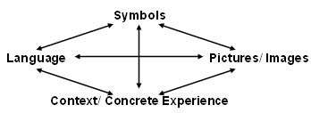
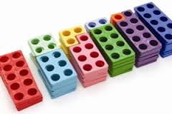
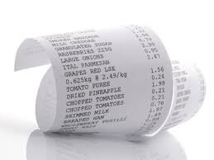
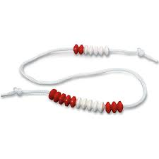
The Connective Model
=
+
x
%
subtract
more
add
sum
factor
product
When we plan a Maths sequence we always ensure children are exposed to correct mathematical language, symbols (+ - = x), an image and a context.
Notes:
MC – when teachers plan a Maths lesson, e.g. addition – symbols, context, correct language.

Slide 22
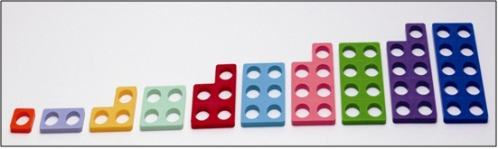
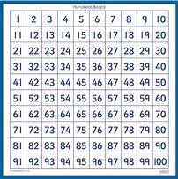
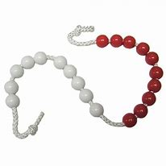
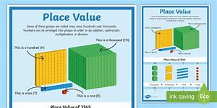
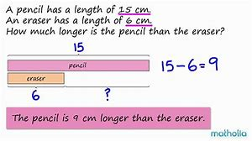
Numicon and Resources

Slide 23
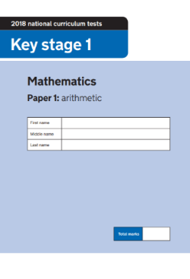
End of KS2 SATs/NFER
At the end of KS2 (Year 6) children will take their end of KS2 SATs and NFER tests are sat termly to review progression in ALL year groups.
This is done in school, with their class teachers. Children are encouraged to do their best.
The children are expected to complete 1 Reading paper, 3 Maths papers and 1 SPaG papers. This is spread out throughout the week.
The Maths SATs consist of an arithmetic paper and two reasoning papers.
The Arithmetic paper which contains 36 questions (40 marks)
Children will have 30 minutes to complete this.
The Reasoning paper consists of 35 marks which can be read to the children if they specifically ask.
The children have 45 minutes to complete this.
Notes:
SJ

Slide 24





2018 Arithmetic Paper
Have a go!
Notes:
SJ - timer

Slide 25
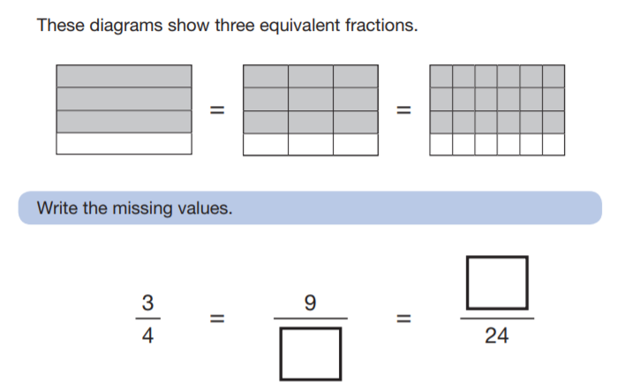
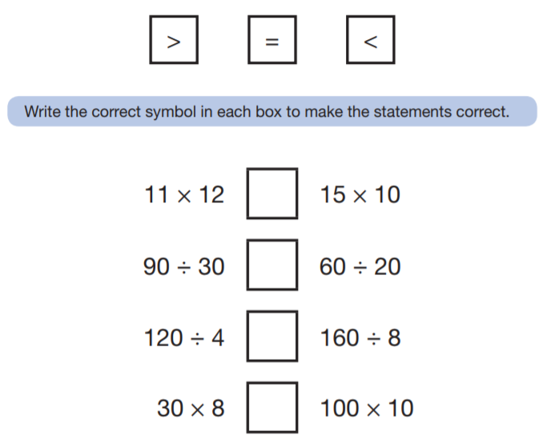
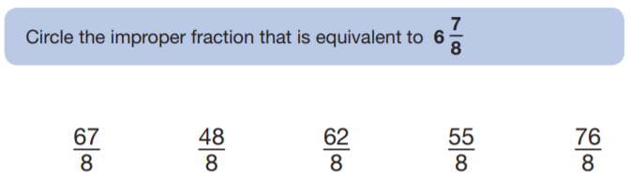
2018 Reasoning Paper
Notes:
SJ

Slide 26
Maths in Action – 15 minutes
Some of our Year 6 children have been chosen as our Mathemagicians!
They are here to show you a variety of methods:
Spend 15 minutes visiting the stations to find out about the methods we use here at Elburton to support FLUENCY and REASONING:
Addition and subtraction written methods.
Multiplication and division written methods.
Adding, subtracting, multiplying and dividing fractions.

Slide 27
HOW CAN YOU HELP?
WHAT WEBSITES CAN BE USED TO HELP YOU?
https://www.mindsetkit.org/growth-mindset-parents/how-parents-can-instill-growth-mindset/3-ways-parents-can-instill-growth-mindset

Slide 28
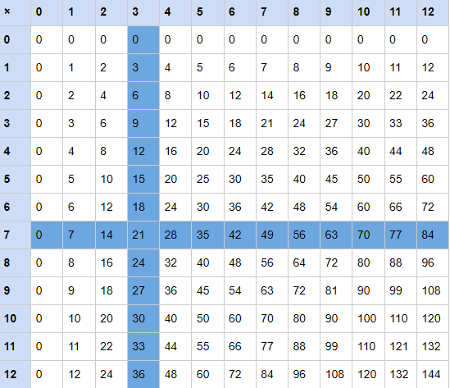
Progression of Times Tables
Year 4 Multiplication Check is now in place for this year.
Your child should be fluent in ALL times tables up to 12 x 12 by the end of Year 4.
Notes:
MC

Slide 29



Slide 30



Speak to any of my rock legend friends, McCartney, Hendrix, Bono, Collins, Springsteen, Rose, etc.,
and they will tell you the hours they spent practising guitar chords and drumming riffs. It's just the
same with times tables – all wannabe rock stars need to
@TTRockStars
ttrockstars.com

Slide 31
practise and practise and practise.
So, I say to you, pick up your hairbrush, your air guitar and your pots-and-pans drumkit, get your friends together and start making music! And while you're at it, why not learn your times tables?
Ziggy Stardust
@TTRockStars
ttrockstars.com

Slide 32
Times tables are one of the foundations/building blocks of maths. You need it to access/support all the even more interesting maths that sits on top.
The multiplicative relationship between amounts is usually more interesting and helpful than the additive relationship as they allow you to describe patterns and make predictions.
@TTRockStars
ttrockstars.com

Slide 33
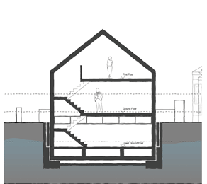
If maths was a house…
All the even more super fun stuff
Graphs, shapes & algebra
Fractions & %
× and ÷
+ and –
Counting
@TTRockStars
ttrockstars.com

Slide 34
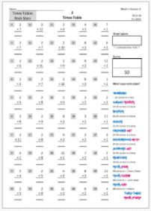
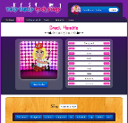

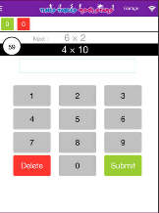
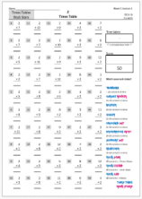
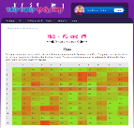
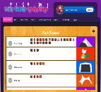

Three Modes
Lesson 1
Lesson 2
Lesson 3
Lesson 4
Lesson 5
Paper
Website
App
@TTRockStars
ttrockstars.com

Slide 35


Slide 36

WHAT IS MYMATHS?
MyMaths is an interactive online teaching and homework service written by experienced teachers for all the UK National Curriculum.
Perfect to use from age 5 upwards.
Provides an important consolidating link between school and home, with access so parents can review their child’s progress

Slide 37

Lessons
MyMaths provides lessons paired with Maths tasks for practice and assessment to develop children’s fluency, reasoning and problem-solving in maths.
Lessons cover Years 1 to 6 and can be used by children of all abilities and you can choose which activity you do with the children.

Slide 38
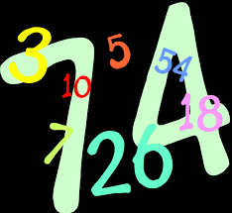
Pupil Area
Questions are randomly generated so children can try the task as many times as they need
Instant marking provides immediate feedback for pupil and teachers
Pupils can rate their understanding of topics
Parents can follow their child’s progress and try the lesson content if they want to refresh their own maths skills.

Slide 39
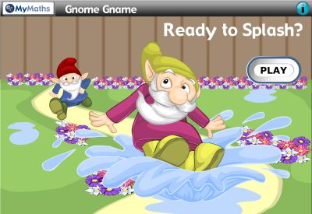
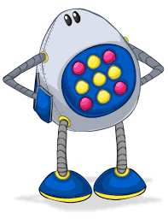
Games
Games are an ideal way of motivating pupils to consolidate their maths skills.
MyMaths games keep maths at the forefront. Each game is tailored to provide a little bit of fun and a lot of practice.

Slide 40
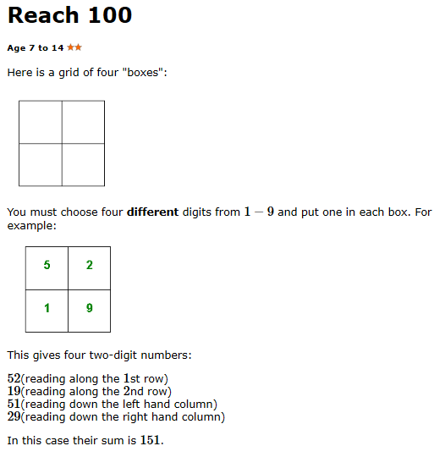
Before you leave…

Slide 41

Thank you for attending tonight; I hope it has been useful!
Thank you to my Year 6 Maths wizards!
If you have any questions, please pop up and see me.
The Powerpoint will be uploaded onto the Elburton website and don’t forget… MATHS IS FUN!
Inspiring today’s children for tomorrow’s world

