Slide 1
Welcome to ‘Getting To Know Year 4’ 2022
Inspiring today’s children for tomorrow’s world

Slide 2
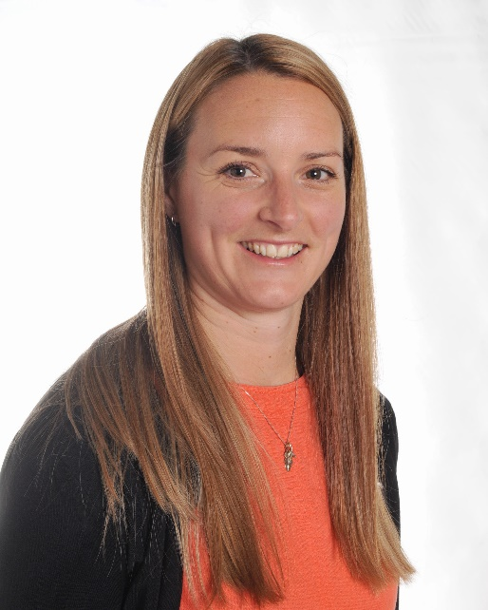
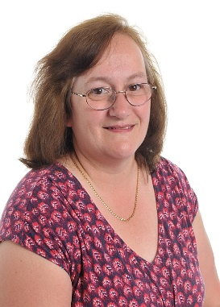
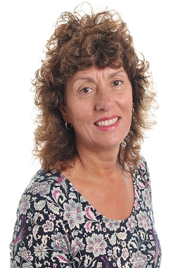
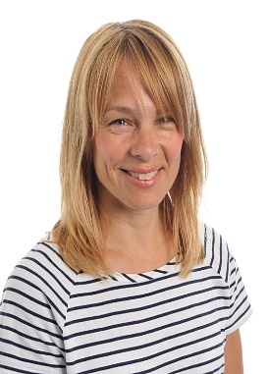
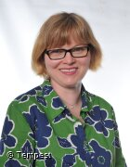
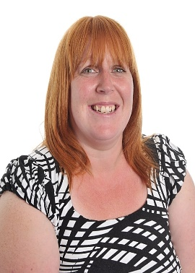
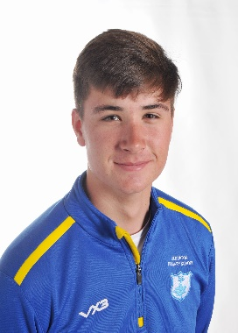
The
Year 4
Team

Slide 3
The Year 4 Team
4CW Hazel – Mrs Woodhams
4SG Hawthorn – Mr Griggs
Teaching Assistants – Mrs Twaits, Mrs Hawkins, Mr Ryan, Mrs Senior and Mrs Causon (ELSA support)
HLTAs – Mrs Poole and Mrs Rhodes
Music – Mr Norman from April 2023 – July 2023
National Tutoring Program – Mrs Fry
Inspiring today’s children for tomorrow’s world

Slide 4
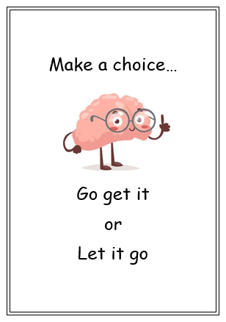
Emotional Logic
During our PSHE lessons we are using a simplified version of Emotional Logic with all children so they can better understand and regulate their emotions. The EL team are available to support further is needed outside of these sessions.

Slide 5
Emotional Logic
Happens when we begin to doubt our resources to cope with something.
Can present in a variety of emotional and physical ways.
Is very personal to individual circumstance.
Creates a plethora of unpleasant feelings.
These feelings are not negative or bad… they are a warning system!
It is important to notice these feelings and name them, not to try and supress them.

Slide 6
Emotional Logic
This starts with finding a safe place (person, place or state of mind).
The thought process of how to overcome the problem starts here.
Ask yourself ‘What do I need to be able to feel like I can cope’?

Slide 7
Emotional Logic
Known as acceptance or bargaining.
This is where a decision is made to take the next step.
Go get it means (bargaining) you have a good plan to help solve the problem (storyboarding with an adult could help here).
Let it go (acceptance) means you have acknowledged that there is nothing you can do and to make peace with it.

Slide 8
Our School Vision
The school’s published mission statement is:
“Inspiring today’s children for tomorrow’s world”
This is supported by the schools core words and aims:
Inspire
We will inspire each other to do the best
We will support each other to set high goals
We will have open minds to new ideas and challenges in the world around us
We will inspire each other to become independent, self-motivated and confident in our own abilities
Pride
We will take pride in how we present ourselves and all our achievements
We are proud to belong to the school and the local community
We take pride from our active participation
We take pride in always doing the best we can

Slide 9
Our School Vision
Flourish
We have high expectations in all we do and how we do things
We will experience a broad, balanced curriculum with exciting experiences
We will learn how to live, work and play together and learn from each other
We will achieve the very best we can attaining personal milestones even if they are small steps
Respect
We value all, irrespective of individual differences
We will show good manners and courtesy to all and take responsibility for our actions
We will respect ourselves through trying our best to be healthy, active and confident
We recognise and promote fundamental British values of tolerance, fair play and being truthful
Safe
We provide a safe, friendly and supportive environment in which to thrive
We foster a nurturing environment in which positive relationships meet all pupils’ needs
We will build happy and positive relationships where pupils feel secure to be wrong!
We will build a community where all feel safe and free from fear

Slide 10
Our Class Vision
Inspire:
We will inspire and support each other to always do our very best. We will be confident when facing new challenges and try hard to develop ways to work more independently.
Pride:
We will take pride in everything we do; we will always try our best when working in the classroom and when being an active member of our school and local community.
Flourish:
We will flourish by having high expectations and enthusiastically engaging in a broad range of learning experiences. We will develop our learning a step at a time and support others in doing the same both inside and outside the classroom.
Respect:
We will show respect by valuing everyone, including ourselves. We will be honest, polite and courteous and take responsibility for our actions in all aspects of life.
Safe:
We will work together to stay safe and ensure that our school and local community feel happy, supported and free from fear. We will try our best to build happy, positive relationships where we can learn together without worry or concern.

Slide 11
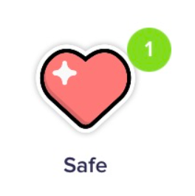
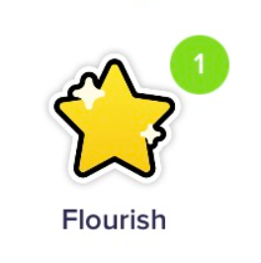
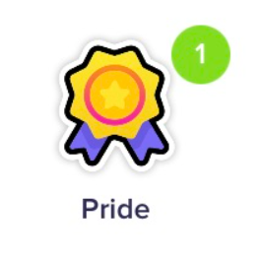
Dojo Points
Dojo is an exciting way of earning rewards linked to our school values. This allows children to receive encouragement and praise for all their efforts to motivate and celebrate achievements.
Our school drivers are:

Slide 12
Dojo Drivers
Each term, children can earn dojo points for demonstrating key skills linked to the school drivers.
25 Dojos they will receive a certificate.
50 Dojos can be spent on a gift from the ‘Dojo treasure box.’
100 Dojos they will be rewarded with a book!
We will update the class story with news and pictures of our learning throughout the year and will also use this as our main port of communication to you for reminders, private messages and other key pieces of information.

Slide 13
Expectations and Daily Organisation
More emphasis on independence and responsibility (personal organisation: pencil cases, home learning, behaviour etc.).
Importance of water bottles (named and refilled at home daily).
Break time snacks (healthy fruit/veg or similar).
PE kits: Outdoor PE (Wednesday) Indoor PE (Mrs Woodhams – Thursday and Mr Griggs - Tuesday)
Kit is as follows: White PE t-shirt, Navy blue shorts, White socks, Elburton hoodie (available from the PTA), Navy blue tracksuit in Winter, Sports trainers which provide full support (no fashion brands)
During the summer term, we hope that the children will be able to swim; swimming kits will need to be in school on the appropriate day (more advice nearer the time).
Inspiring today’s children for tomorrow’s world

Slide 14
Key Dates
Hindu Speaker (Autumn 1)
Roman Day (Autumn 2)
Bodmin Jail Visit (Spring 2)
Geography Fieldwork Sherford (Summer 1)
Egyptian Day (Summer 2)
Mount Batten - Monday 12th and Tuesday 13th June 2023 (Summer 2)
Year 5 Residential – Deposit to be paid during Summer term 1.

Slide 15
THE CURRICULUM
To view this please visit the Year 4 class page on the school website.

Slide 16
Mathematics
Maths objectives are based on the National Curriculum
We follow the White Rose Scheme for maths where the children learn through a series of small steps which build to consolidate their understanding. These lessons are grouped into blocks ranging in length from 1-5 weeks depending on content.
We have a ‘confident to be wrong’ approach to maths; it’s important for children to understand that they can learn from their mistakes.
The children also complete daily morning maths tasks focussing on fluency – 2/3 times a week.
Times Tables Rock Stars is used in class and at home to develop quick recall of multiplication facts. Please encourage your child to access this at home and to practise their times tables three times a week (5-10 mins) Children are expected to know all the times tables up to and including 12 x 12 by the time they leave Year 4.
Inspiring today’s children for tomorrow’s world

Slide 17
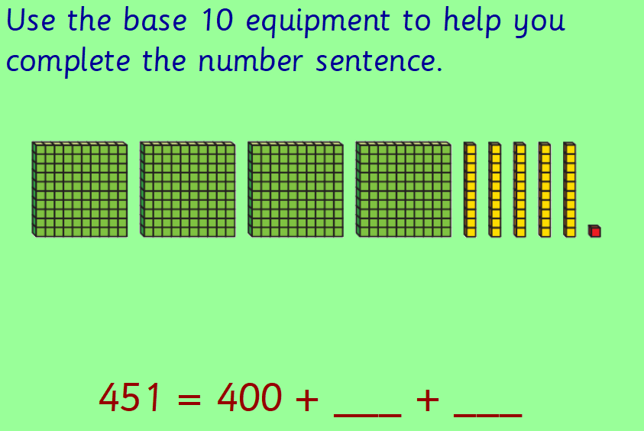
The children use manipulatives and representations to help visualise numbers and mathematical problems.
Inspiring today’s children for tomorrow’s world

Slide 18
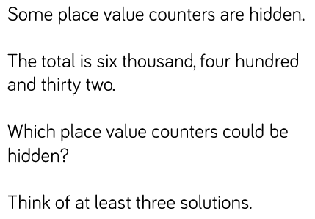
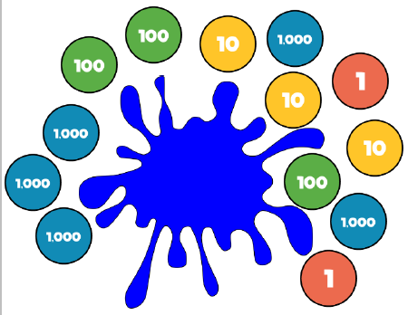
An example of independent learning in maths
Problem Solving:
Independent work:
1. Look at the representation. Record six different ways of partitioning this number.
2. Josh says, “My number has 4 thousands, 8 hundreds and 27 ones”. What is Josh’s number?
Inspiring today’s children for tomorrow’s world

Slide 19
Reading
Children are expected to read at home with an adult for 10-15 minutes, three to five times a week.
We develop children’s reading in various ways including whole class reading, paired and independent reading.
A variety of different genres are chosen to ensure that the children are exposed to a range of vocabulary, styles and purposes.
We also have a class reader which is read throughout the week. Our current class reader is The Iron Man, which also links to our current English unit.
Children’s Reading Records need to be kept up to date and we shall be checking these on a Friday – please ensure the children read to you as well as read independently and get their reading signed by an adult – 3 times a week for a dojo point! If children struggle to find time to read at home, time can be found during the school day at appropriate times.
Inspiring today’s children for tomorrow’s world

Slide 20
Reading
There is a big emphasis on reading again this year in order to raise the profile of reading throughout the school. We have several initiatives to enhance the children’s love of reading and to enrich their vocabulary:
Word of the Day
Developing higher order reading skills (Vocabulary, Inference, Prediction, Explanation, Retrieve and Summarise) - VIPERS
Class reader – Iron Man
New book banded books which have been purchased especially for the new year.
The library – Children will get to spend time perusing the books in our library filled with non-fiction and fiction books!
Inspiring today’s children for tomorrow’s world

Slide 21
Accelerated Reader
Accelerated Reader is a computerised program that is designed to improve children’s reading ability and to raise their reading age. We will continue to use this system where children can quiz and work their way through the book bands.
The Accelerated Reader Program works by identifying a child’s ZPD (Zone of Proximal Development) which is a selection of books that will not only match their ability, but will also challenge them and develop their vocabulary.
Each child takes an online comprehension test in order to determine their ZPD – Star Reading Test

Slide 22
Accelerated Reader
Children will be directed to choose books from the class library that fall within this range. When they have ﬁnished the book, they will take a short, electronic quiz that assesses their understanding.
It also enables teachers to closely monitor individual reading progress and ensure that children are selecting books that are challenging enough to meet their individual needs.
Children are encouraged to read books linked to the school's AR award system which monitors the challenge, quizzes as well as number of words children are reading. They need to read 5 books in the same book band before being invited to move up to the next decimal point band level. This is also dependant on their AR quizzes which they undertake.
Certificates are awarded for 15, 30, 45, 60 and 75 books read, quizzed and successfully understood.

Slide 23
Home Learning 2022
The children will receive one piece of Maths and one piece of English work on alternate weeks and occasionally, another relevant topic-related piece.
This will be given out on a Monday and expected to be back in class by the Friday of the same week – this will give them (as well as you) time to enjoy the weekend fully.
This is alongside their reading, Spelling Shed and Times Table Rockstars work which they should be completing 3 times a week for 5 – 15 minutes at a time.
Please get your child into a routine of completing the home learning and bringing it back into school. It is so important they acquire this skill as they grow older.

Slide 24
RWInc Spelling
As a school, we are now completing spellings on a daily basis in KS2 following the Read, Write, Inc. Spelling program. This ensures continuity from the phonics learnt in KS1 and is structured so that children complete various activities which help them to learn age-related spelling rules.
We will introduce a new spelling rule every Monday in school and practise it throughout the week. These weekly spellings will be set on Spelling Shed for the children to practise at home (at least 3 times a week) and will be tested the following Friday.

Slide 25
Writing
Through the year, we will cover a range of genres. Currently, we are working on our fiction writing where children are developing and extending their sentences and including features such as similes, metaphors and repetition for effect.
There will be a focus on pride in all written work throughout all subjects.
Children will be involved in both self and peer assessment to help them improve their writing.
Throughout the year, children will have lots of opportunities to draft and edit longer pieces of writing.
In Year 4 we will be working hard to ensure that children are confident and accurate with punctuation and that they are consistently using cursive handwriting following the LetterJoin scheme.
Inspiring today’s children for tomorrow’s world

Slide 26
E-Safety
This is an important issue for children and adults.
There are some documents to support E-Safety on our school website on the Year 4 class page – these are aimed at both children and parents.
If you should have any concerns or feel we should be notified about any inappropriate online content, please don’t hesitate to let us know.
Inspiring today’s children for tomorrow’s world

Slide 27
How to Help
Continue to listen to your child read regularly (at least 3 times per week) and record this in their reading record with a comment – we check these on a weekly basis.
Sign-up for the Reading Army if you’d like to – a letter should have already been sent out through the office.
Be involved in home learning (but don’t do it for them!).
Help your child learn multiplication facts.
Promote a positive attitude to learning - please don’t share negative school experiences. Promote positivity!
Insist on the basics in writing and in speech at all times.
Inspiring today’s children for tomorrow’s world

Slide 28
We hope that you have found this information useful.
Please contact us via Class Dojo or email should you need anything at all.
Thank you for your continued support.
Inspiring today’s children for tomorrow’s world

