Slide 1
Welcome to the ‘Getting To Know Year 6’ 2022
Inspiring today’s children for tomorrow’s world

Slide 2
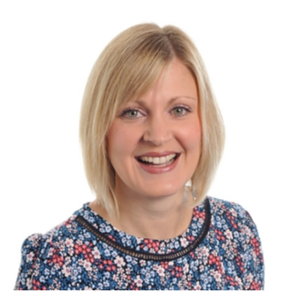
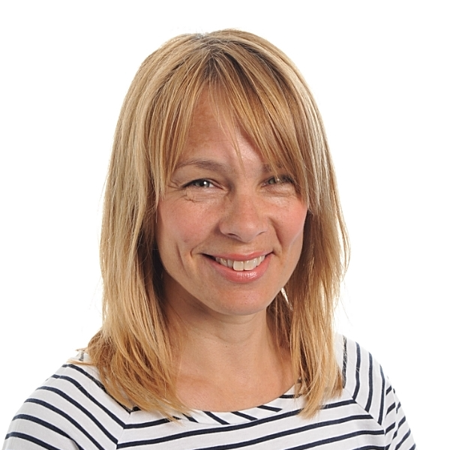
The Year 6 Team
Maple – Miss Marriott
Magnolia – Mrs Bates
Teaching Assistants – Mrs Rhodes and Mrs Humphreys
MFL – Mrs Burton
Music – Mr Norman: From September to December

Slide 3
Class Dojo is an exciting way of earning rewards linked to our school values. This allows children to receive encouragement and praise for all their efforts to motivate and celebrate achievements.
Each term, children can earn dojo points for demonstrating key skills and learning behaviours linked to the school values.
25 dojos they will receive a certificate,
50 dojos can be spent on a gift from the ‘Dojo treasure box,’
100 dojo they will be rewarded for their outstanding efforts with a book!

Slide 4
Our School Aims and Values
Since returning to school we have introduced new aims and values which are linked to positive learning behaviours and attitudes. This allows children to develop lifelong skills alongside learning key knowledge.

Slide 5
This year, Class Dojo will continue to be our main communication tool between home and school.
Each Friday, we will update the class story with news and pictures of our learning throughout the week.
During the year, we will use the ‘Class Story’ to post key information about forthcoming events such as trips, themed days and general remainders.
As in the previous year, your child can send us photographs and examples of work using the portfolio function.
If you need to communicate with your child’s class teacher/teaching team, you can do so using the messaging tool.

Slide 6
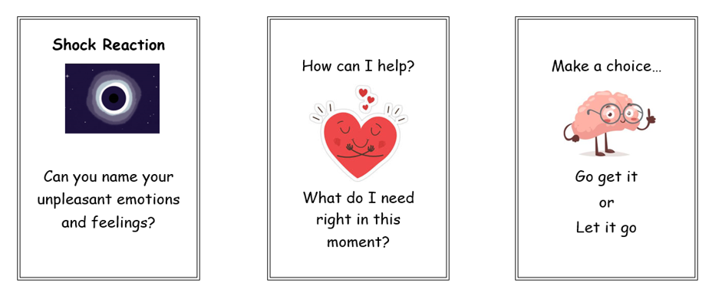
Emotional Logic
We are using the principles of Emotional Logic as we teach the children about their emotional well-being. Through conservations with the children, we demonstrate that emotions are important and help us to manage our feelings.

Slide 7
Emotional Logic
Shock reaction happens when we begin to doubt our resources to cope with something.
Can present in a variety of emotional and physical ways.
Is very personal to individual circumstance.
Creates a plethora of unpleasant feelings.
These feelings are not negative or bad… they are a warning system!
It is important to notice these feelings and name them, not to try and supress them.

Slide 8
Emotional Logic
This starts with finding a safe place (person, place or state of mind).
Important to be present or in the moment to reassess the situation.
The thought process of how to overcome the problem starts here.
Ask yourself, ‘What do you need to be able to feel like you can cope’?

Slide 9
Emotional Logic
Known as acceptance or bargaining.
This is where a decision is made to take the next step.
Go get it means (bargaining) you have a good plan to help solve the problem.
Let it go (acceptance) means you have acknowledged that there is nothing you can do and to make peace with it.

Slide 10
Expectations and Daily Organisation
More emphasis on independence and responsibility (Personal organisation: homework, behaviour, reading records, PE kits etc.).
Importance of water bottles (named and refilled at home daily).
Break time snacks (healthy fruit/veg or similar).
PE kits: Indoor PE (Tuesday) Outdoor PE (Thursday)
PE Kit: White PE t-shirt, Navy blue shorts, White socks, Elburton hoodie (available from Trutex), Navy blue tracksuit in Winter, Sports trainers. *Please ensure PE kits are clearly named.
During the summer term, we hope that the children will be able to swim; swimming kits will need to be in school on the appropriate day (more advice nearer the time).

Slide 11
Curriculum Map: Autumn 2022

Slide 12
SATs
At this time, we are under the assumption that the children will take their KS2 SATs tests this year.
The testing week will be:
Monday 8th May – Friday 12th May 2023
We hope that the children understand their whole education is important and although we will prepare the children for SATs they will still receive a broad and balanced curriculum.

Slide 13
SATs
The tests will consist of 3 papers:
Spelling, Punctuation and Grammar (SPaG):
- 45 minutes multiple-choice and short answers
- Spelling: 20 marks
- Punctuation and grammar test: 50 marks
Reading Paper:
- 3 extracts in a comprehension paper: 60 minutes
Maths:
- 1 arithmetic paper
- 2 reasoning papers
Writing:
Ongoing moderation throughout the year.
Writing moderation across all subjects.

Slide 14
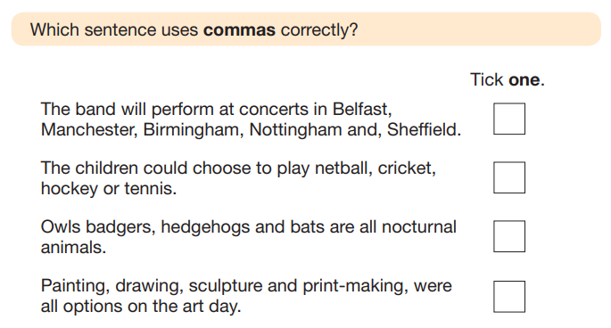
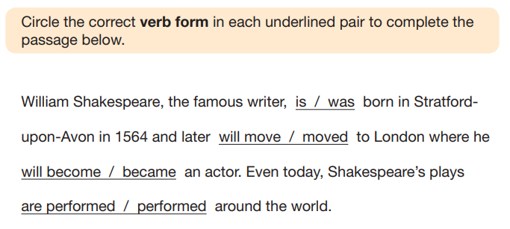
SATs
Spelling, Punctuation and Grammar (SPaG):

Slide 15
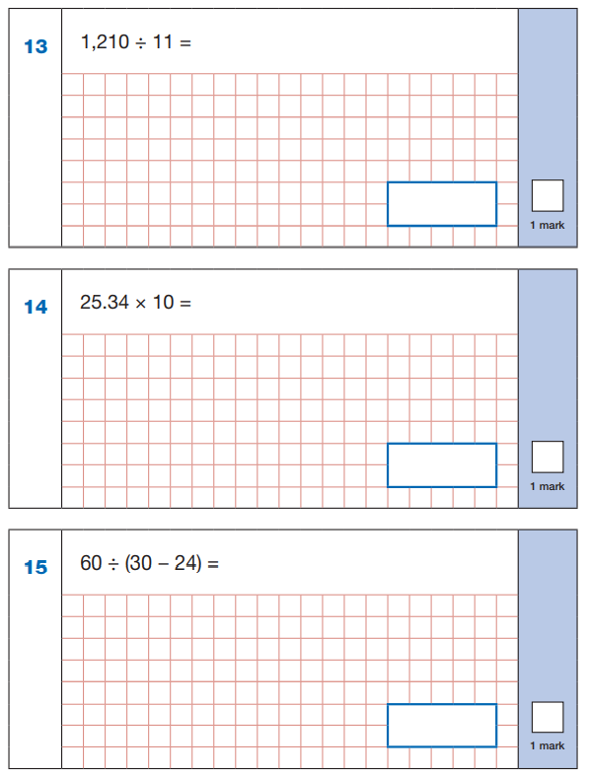
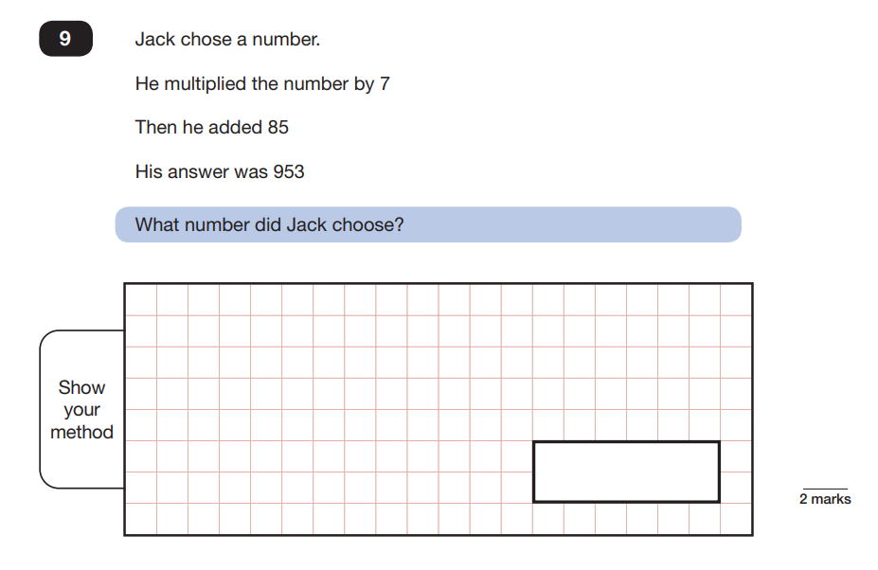
SATs
Maths Papers: Arithmetic and Reasoning

Slide 16
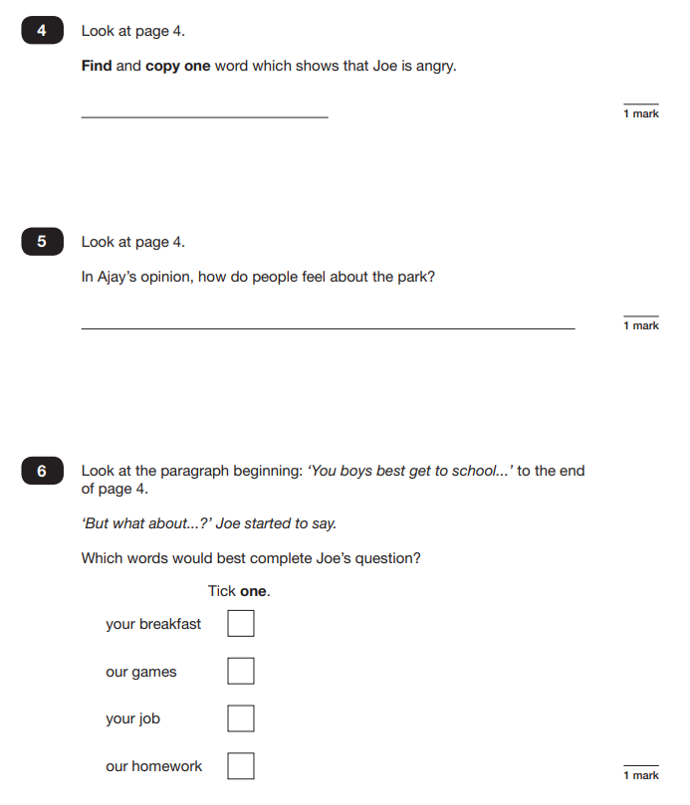
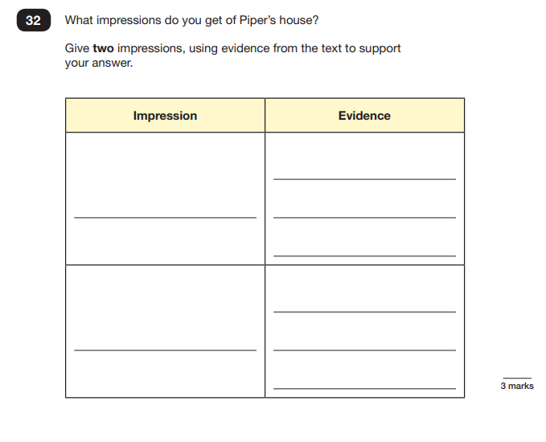
SATs
Reading Paper:

Slide 17
Mathematics
Maths objectives are based on the National Curriculum.
We follow the White Rose Scheme for maths where the children learn through a series of small steps which build to consolidate their understanding. These lessons are grouped into blocks ranging in length from 1-5 weeks depending on content.
We have a ‘confident to be wrong’ approach to maths; it’s important for children to understand that they can learn from their mistakes.
The children also complete morning maths tasks focusing on fluency.
Times Tables Rock Stars is used in class and at home to develop quick recall of multiplication facts. Please encourage your child to access this at home and to practise their times tables three times a week (5-10 mins) Children are expected to know all the times tables up to and including 12 x 12 by the time they reach Year 6.

Slide 18
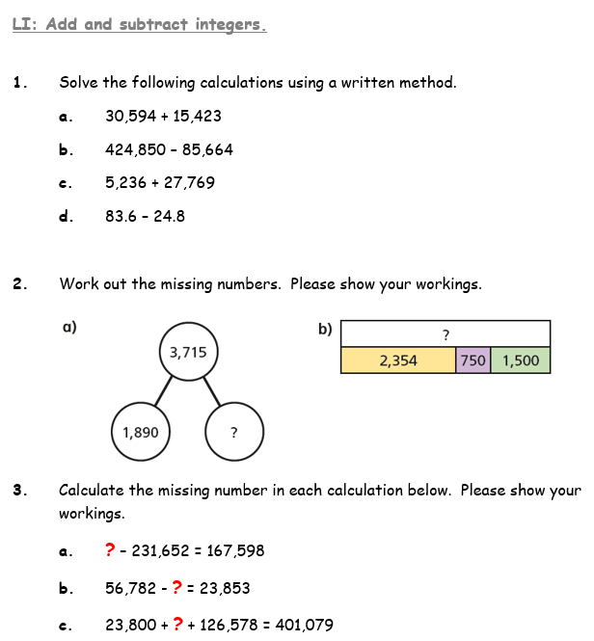
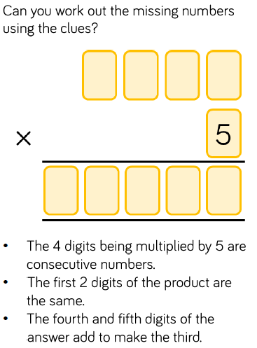
An example of independent learning in maths
Fluency work:
Problem Solving:

Slide 19
Reading
Children are expected to read at home with an adult for 10-15 minutes, three times a week. This should be initialled by an adult to indicate that the reading has taken place.
We develop children’s reading in various ways including whole class reading, paired and independent reading.
A variety of different genres are chosen to ensure that the children are exposed to a range of vocabulary, styles and purposes.
We also have a class reader which is read throughout the week.
Children’s Reading Records need to be kept up-to-date and we shall be checking these on a Friday during our ‘Book Check’ time. Please ensure your child reads to you as well as independently throughout the week.

Slide 20
Reading
Reading is crucial to our children’s academic success for a number of reasons. We have several initiatives to enhance the children’s love of reading and to enrich their vocabulary:
Word of the Day
Developing higher order reading skills (Vocabulary, Inference, Prediction, Explanation, Retrieve and Summarise) - VIPERS
Class reader – Pig Heart Boy and Street Child
The NEW library – Children will get to spend time enjoying the books in our new and improved library filled with a range of non-fiction and fiction books!

Slide 21
Accelerated Reader
Accelerated Reader is a computerised program that is designed to improve children’s reading ability and to raise their reading age.
The Accelerated Reader Program works by identifying a child’s ZPD (Zone of Proximal Development) which is a selection of books that will not only match their ability, but will also challenge them and develop their vocabulary.
Each child takes an online comprehension test in order to determine their ZPD – Star Reading Test. The children will have been given a decimal number which falls in this range. They will read and quiz on three books at this level. If the children pass all three quizzes (80 – 100%), they will be able to move to the next decimal level. Once they reach 6.1, they will become free readers and have access to all the books in the library areas.

Slide 22
Accelerated Reader
Accelerated Reader enables teachers to closely monitor individual reading progress and ensure that children are selecting books that are challenging enough to meet their individual needs.
Children are encouraged to read books linked to the school's AR award system which monitors the challenge, quizzes as well as number of words children are reading.
AR Reading Champions: Certificates are awarded for 10, 20, 30, 40 and 50 books read, quizzed and successfully understood.
AR Word Certificates: Children will also work towards a word reading total as part of the AR system and gets certificates for every 250,000 words read.

Slide 23
Writing
Through the year, we will cover a range of genres which are based around high quality texts that enrich the children’s vocabulary and knowledge of topics.
There will be a focus on pride in all written work throughout all subjects.
Children will be involved in both self and peer assessment to help them improve their writing through the editing process.
Throughout the year, children will have lots of opportunities to draft and edit longer pieces of writing. These will culminate in 4 -5 pieces a year being published in their ‘Writing Progress’ books.
Non-negotiables for writing will include capital letter, full stops and joined, cursive handwriting following the LetterJoin scheme.

Slide 24
RWI Spelling
This year, we have introduced Read, Write Inc Spelling as our tool for delivering the spelling curriculum. On Mondays, the children will be introduced the spelling pattern for the week. Throughout the week, they will complete consolidation activities to embed and deepen the spelling rule / pattern.
We will continue to send home spellings on a Monday and they will be uploaded onto Spelling Shed to enable the children to practise them in preparation for the spelling test on Friday.
It is very important that the children continue to learn the Year 5/6 statutory words and this will be revised and tested throughout the year.

Slide 25
Homework
The children will receive one piece of Maths, one piece of English work per week and weekly spellings to learn.
This will be given out on a Monday and expected to be back in class by the Friday of the same week – this will give them as well as you time to enjoy the weekend fully.
Additionally, children are expected to use Spelling Shed and Times Table Rock Stars 3 times a week for 5 – 15 minutes at a time. We understood that this is not always possible. However, we encourage regular activity on these platforms to consolidate class learning.
We will mark the children’s work with them on a Friday and provide oral feedback in order to address any misconceptions as they arise.
Please get your child into a routine of completing the homework and bringing it back into school. It is so important they acquire this skill of being in a routine as they get ready for transition to secondary school.

Slide 26
End of Year 6 Arrangements
End of Year Oscars
This year, we hope to build on from the last two year’s successful ‘Oscar Evening’.
The children be invited into the school hall during the evening and will have a formal celebration with awards, food and drinks and dancing with their friends.
We politely request that no limos or transportation is arranged to collect the children at the end of the evening to ensure the safety and inclusion of all our Year 6 children.
Inflatable Fun Day
We are hoping to arrange another end of year Inflatable Fun Day during the last week of term.

Slide 27
E-Safety
This is an important issue for children and adults.
There are some documents to support E-Safety on our school website on the Year 6 class page.
If you should have any concerns about any inappropriate online content or behaviour, please don’t hesitate to let us know.

Slide 28
Secondary Transition
The deadline for applying for your child’s Year 7 place is the 31st October 2022.
Over the next few weeks, secondary schools in the area are holding open evenings for you to visit prior to applying for their place. If we receive information from the schools, we will send it out through Dojo.
During the summer term, the secondary schools will be able to offer a comprehensive transition programme for your child which will include an onsite visit. Additionally, the secondary teachers will come into Elburton to meet the Year 6 classes.
For some children, who have additional needs, may be offered an ‘Enhanced Transition’ which will be arranged on your behalf. Our SEND Lead, Mrs Birnie, will be able to offer more information about this should you require it.

Slide 29
How to help your child
Continue to listen to your child read regularly (at least 3 times per week) and record this in their reading record with a comment – we check these on a weekly basis.
Be involved in homework (but don’t do it for them!).
Help your child learn their multiplication facts.
Help them to develop their mathematical fluency through regular arithmetic practice.
Practise spellings throughout the year to reinforce them.
Promote a positive attitude to learning at home and share your child’s learning journey with them.
Insist on the basics in writing and in speech at all times (Grammar, Handwriting, Spelling and Punctuation).

Slide 30
We hope that you have found this information useful.
Thank you for your continued support.

