Slide 1
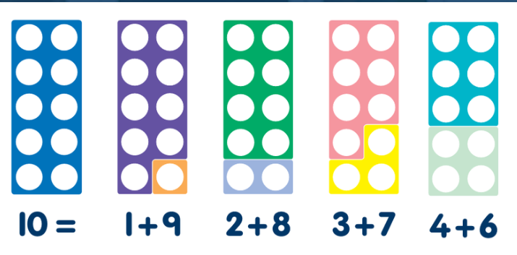
Helping my child with Maths in Key Stage 1 Elburton Primary School
“Life is a math equation. In order to gain the most, you have to know how to convert negatives into positives.”
Notes:
SJ

Slide 2
Aims of meeting
To get an insight into how Maths is taught at Elburton Primary.
To gain an understanding of the National Maths curriculum and expectations.
To take part in a variety of Maths activities – DON’T PANIC!
To take away some ideas to support your children at home.
To be introduced to resources which you can encourage your child to use at home and you can use to support them with their Maths learning.
Notes:
SJ

Slide 3
Before we start…
Be positive about maths. Don't say things like "I can’t do maths" or "I hated maths at school"; your child might start to think like that themselves.
Point out the maths in everyday life. Include your child in activities involving maths such as using money, cooking and travelling.
Praise your child for effort rather than talent - this shows them that by working hard they can always improve.
If you struggle with maths yourself - try our free online tool the National Numeracy Challenge to improve your maths level.
TOP TIPS!

Slide 4
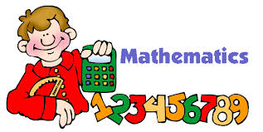
Thinking is at the heart of Mathematics and therefore should be at the heart of Mathematical teaching and learning. At Elburton Primary, we believe that all children can do Maths (and do it well) Increased engagement can lead to a 30% improvement in attainment!
https://www.youtube.com/watch?v=sLPFaOvhlKw
Notes:
SJ

Slide 5
Visualisation: Warm Up How many dots can you see? How did you see them?
Notes:
SJ – thumbs up when you know how many dots there are, NO SHOUTING out.
Finger is you can see the dots in another way – share
Subitising – automatic recognition (latin) without counting.

Slide 6
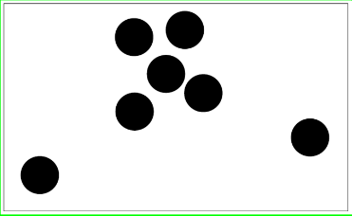
Notes:
SJ – thumbs up when you know how many dots there are, NO SHOUTING out.
Finger is you can see the dots in another way – share
Subitising – automatic recognition (latin) without counting.

Slide 8
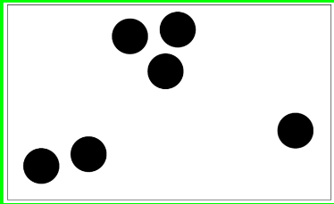

Slide 10
The National Curriculum
The National Curriculum states that children should:
Become fluent in the fundamentals of mathematics, including through varied and frequent practice with increasingly complex problems over time, so that pupils develop conceptual understanding and the ability to recall and apply knowledge rapidly and accurately.
Reason mathematically by following a line of enquiry, conjecturing relationships and generalisations and developing an argument, justification or proof using mathematical language.
Solve problems by applying their mathematics to a variety of problems with increasing sophistication, including breaking down problems into a series of simpler steps and persevering in seeking solutions.
Notes:
MC - 2015 – New Maths Curriculum – called Mastery curriculum. This means that teachers should focus on key concepts and not move on until all children have mastered that particular area. Within Maths there are three main elements that inter-weave.
Fluent –
Reasoning –
Problem solving

Slide 11
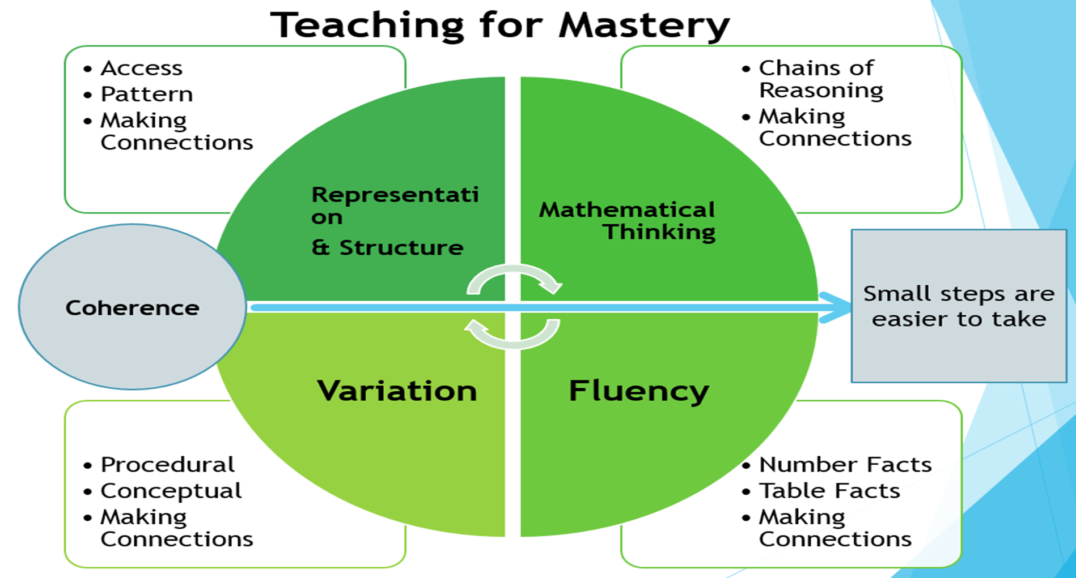

Slide 12
Maths?

Slide 13
Key elements of a Mastery Curriculum in Maths
Whole Class Moves Through Content At The Same Pace
When teaching maths for mastery, the whole class moves through topics at broadly the same pace. Each topic is studied in depth and the teacher does not move to the next stage until all children demonstrate that they have a secure understanding of mathematical concepts.

Slide 14
Key elements of a Mastery Curriculum in Maths
Builds Self-Confidence In Learners
In a traditional primary school maths lesson, children are put in different groups and given different content based on their anticipated ability.
This means that from an early age children are classed as those who can and can’t “do maths”.
Teaching maths for mastery is different because it offers all pupils access to the full maths curriculum. This inclusive approach, and its emphasis on promoting multiple methods of solving a problem, builds self-confidence and resilience in pupils.

Slide 15
Key elements of a Mastery Curriculum in Maths
Differentiates Through Depth Rather Than Acceleration
Though the whole class goes through the same content at the same pace, there is still plenty of opportunity for differentiation. Unlike the old model, where advanced learners are accelerated through new content, those pupils who grasp concepts quickly are challenged with rich and sophisticated problems within the topic.
Those children who are not sufficiently fluent are provided additional support to consolidate their understanding before moving on.

Slide 16
Key elements of a Mastery Curriculum in Maths
Time To Think Deeply About The Maths
Students are given time to think deeply about the maths and really understand concepts at a relational level rather than as a set of rules or procedures.
This slower pace leads to greater progress because it ensures that students are secure in their understanding and teachers don’t need to revisit topics once they’ve been covered in depth.

Slide 17
Progression across the school has been agreed bearing in mind the National curriculum as well as a scheme produced by the White Rose Maths Hub.
The progression of skills can be found on the Elburton School website.
EYFS | Year 1
Count reliably up to 10 objects | Count to and across 100, forwards and backwards, beginning with 0 or 1, or from any given number
Estimate how many objects they can see and check by counting | identify and represent numbers using objects and pictorial representations including the number line
Use language such as ‘more’ or ‘fewer’ to compare two numbers | use the language of: equal to, more than, less than (fewer), most, least
Recognise numerals 1-9 | read and write numbers from 1 to 20 in numerals and words.
Count aloud in ones, twos, fives or tens | count, read and write numbers to 100 in numerals; count in multiples of twos, fives and tens
Year 2
Pupils count fluently forwards and backwards in 10s, starting at any 1 or 2 digit number
Place and identity 2 digit numbers on a number line using their understanding of how close the numbers are to multiples of 10
Pupils recognise commutativity as the relationship between subtraction and addition. Subtraction meaning take away, difference, how many more.
count in multiples of twos, threes, fives and tens from any given number
Notes:
SJ

Slide 18
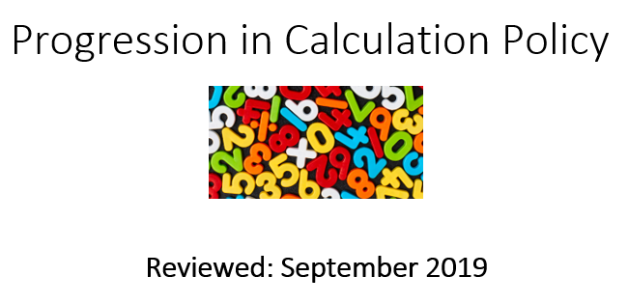
The Calculation Policy can also be found on the website for your reference.

Slide 19
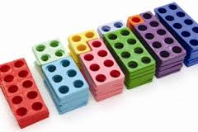
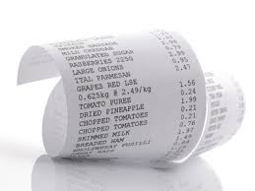
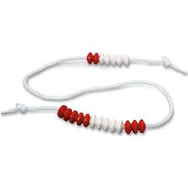
The Connective Model
=
+
x
%
subtract
more
add
sum
factor
product
When we plan a Maths sequence we always ensure children are exposed to correct mathematical language, symbols (+ - = x), an image and a context.
Notes:
MC – when teachers plan a Maths lesson, e.g. addition – symbols, context, correct language.

Slide 20
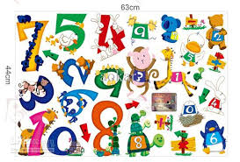
Number Sense!
Children need to understand our number system, starting with counting numbers, building an understanding of how our numbers work and fit together. This includes exploring place value and comparing and ordering numbers then
applying this understanding
in different contexts.
Notes:
MC

Slide 21
Tens Frames These help us to organise our counting. Which one here would be the most useful to you?

Slide 22
Tens Frames and Addition This supports the children to see 9 and 1 more counter would equal 10. Therefore 9+ 3 = 12

Slide 23
Numicon This has been a vital tool in exploring number sense with many children

Slide 24
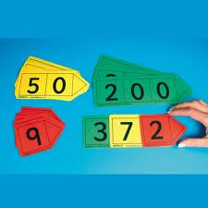
Key Stage 1: Place Value
Place value is at the heart of the number system. All digits have a value and a secure understanding of this will enable children to use and understand different calculation methods.
We constantly ask our children to tell us what each digit in a number represents.
E.g. 24 – The 2 represents 2 tens, the 4 represents 4 ones.
Notes:
Sj

Slide 25
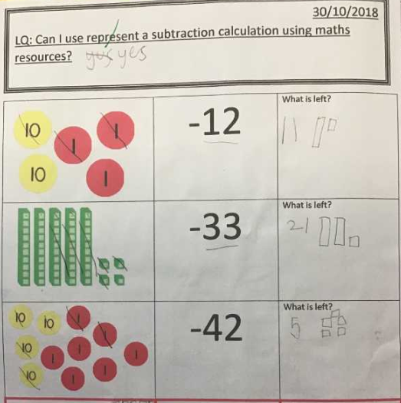
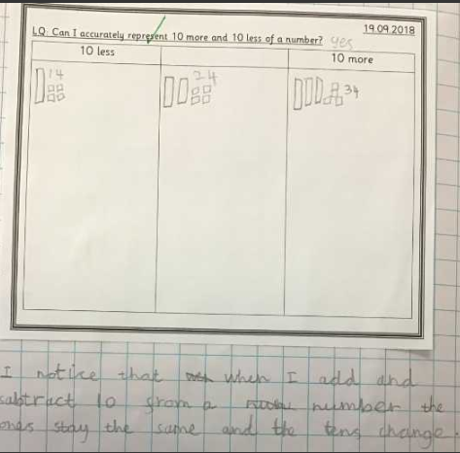
Concrete, Pictorial to Abstract
24 + 10 =
24 – 10 =
23-12=11
Notes:
MC

Slide 26
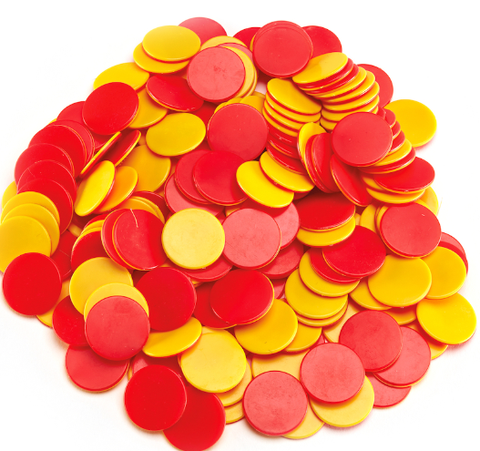
Playing with numbers! How many different ways can you make 5?
Notes:
SJ

Slide 27
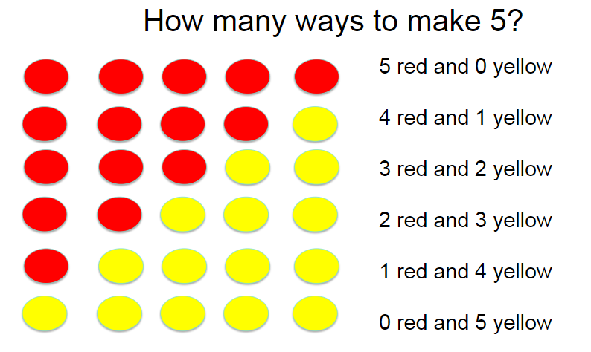
Fluency
It is important that children recognise number bonds, different pairs of numbers with the same total and that they are fluent in this.
Children need to be secure on bonds to 10 by the end of Year 1.
Notes:
SJ

Slide 28
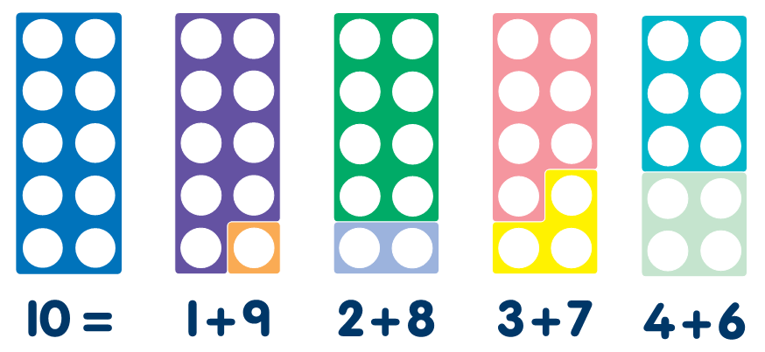
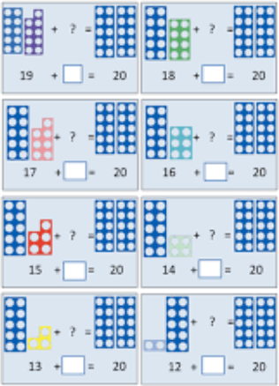
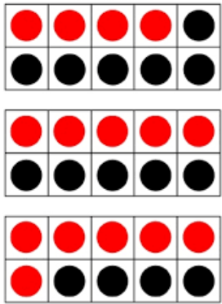
Bonds to 10 & 20 This helps us to build the rapid recall of number bonds throughout Key Stage 1
Notes:
SJ

Slide 29
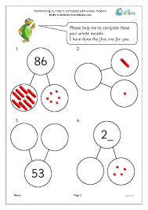
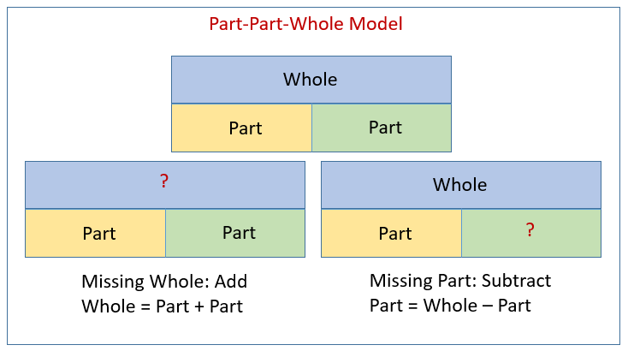
The Bar Model & Part, Part Whole!

Slide 30
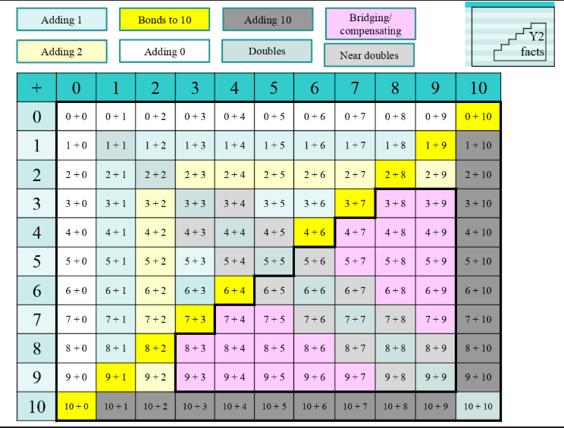
This grid shows the number facts children should be secure on by the end of Year 1 and 2.
Notes:
MC

Slide 31
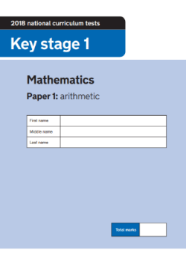
End of KS1 SATs/NFER
At the end of KS1 (Year 2) children will take their end of KS1 SATs and NFER tests are sat termly to review progression.
This is done in school, with their class teachers. Children are encouraged to do their best.
The children are expected to complete 2 Reading papers, 2 Maths papers and 2 SPaG papers. This is spread out throughout the week.
The Maths SATs consist of an arithmetic paper and a reasoning paper.
The Arithmetic paper which contains 25 questions. Children will have 20 minutes to complete this although this is not strictly timed.
The Reasoning paper consists of 35 questions which can be read out to the children. The children have 30 minutes to complete this, although this is not strictly timed.
Notes:
SJ

Slide 32
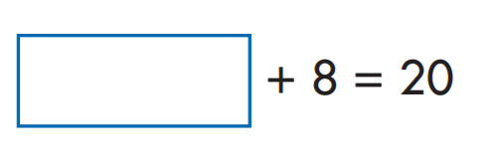
2018 Arithmetic Paper
Have a go!
Notes:
SJ - timer

Slide 33
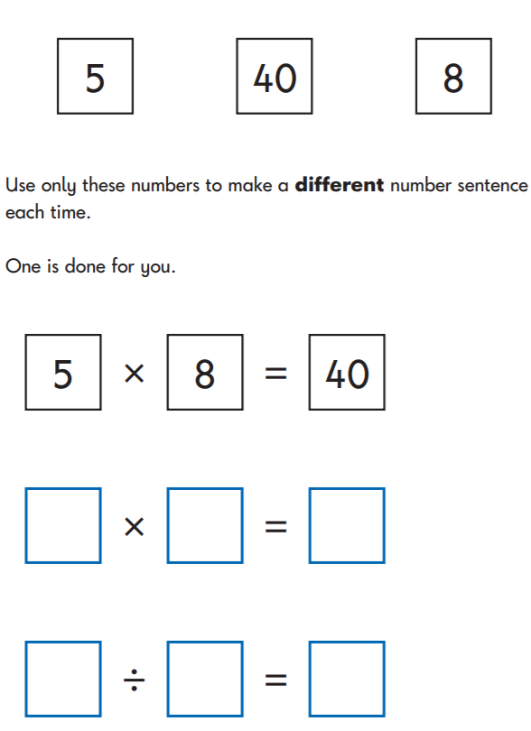
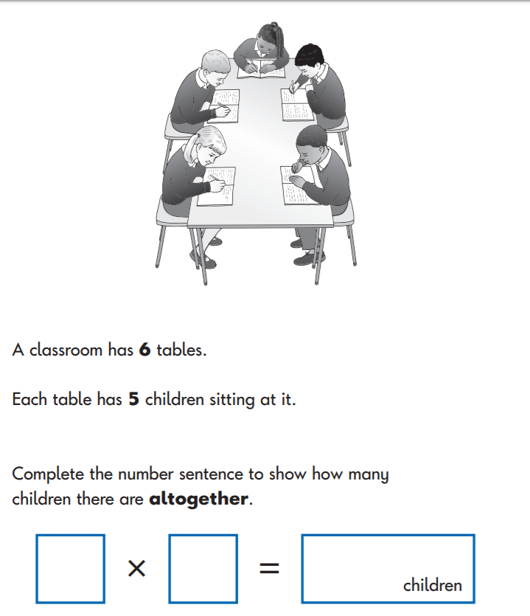
2018 Reasoning Paper
Notes:
SJ

Slide 34
HOW CAN YOU HELP?
WHAT WEBSITES CAN BE USED TO HELP YOU?
https://www.mindsetkit.org/growth-mindset-parents/how-parents-can-instill-growth-mindset/3-ways-parents-can-instill-growth-mindset

Slide 35
YEAR 2

Slide 36
Notes:
Press play to play the video. You may need to wiggle the cursor. If your computer is struggling, here’s the video on YouTube: https://youtu.be/I2L9N8Nbn3U

Slide 37
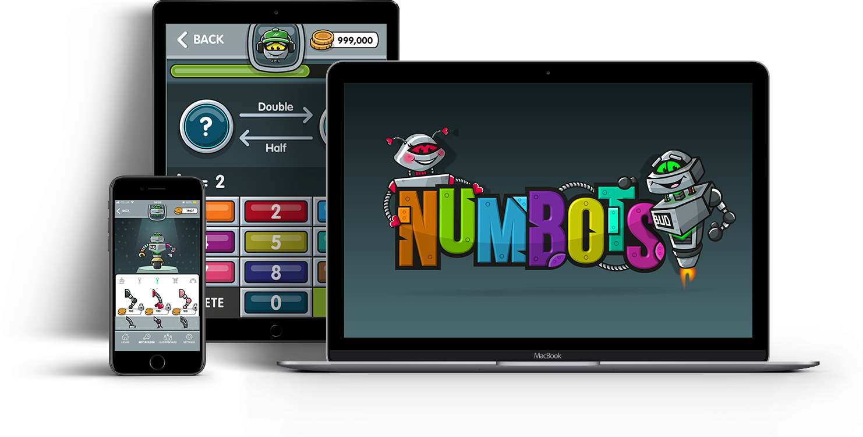
[Menu]
100
Notes:
Available on different devices.

Slide 38
[Menu]
These are called Stages.
There are 18 Stages.
Next slide
Notes:
There are 18 stages. You start on Rust.
Rust stage contains 5 training levels to familiarise pupils with the interface.

Slide 39
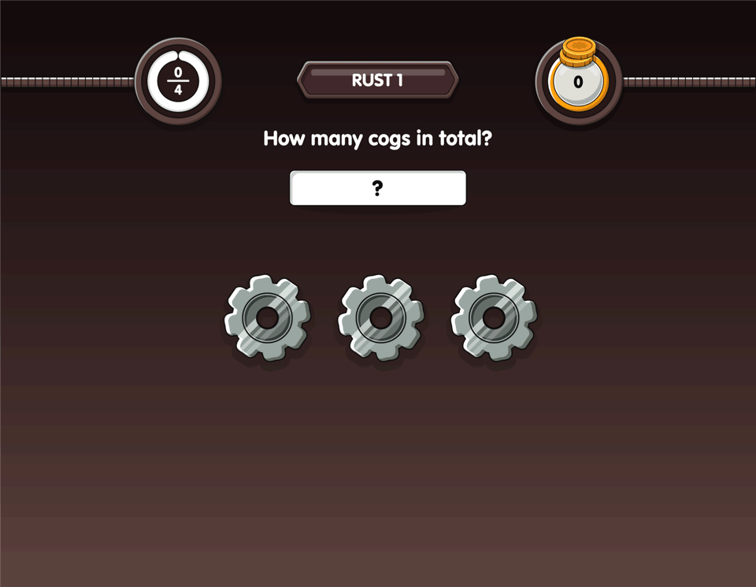
[Menu]
Notes:
The purpose of this animation is to show the pupils that you need to press Enter after each answer.

Slide 40
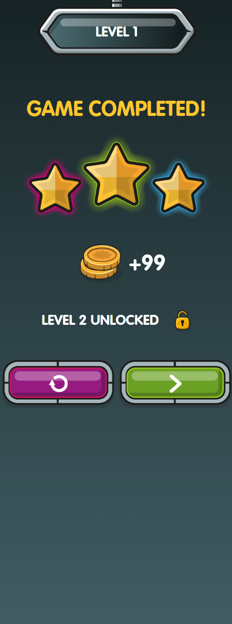
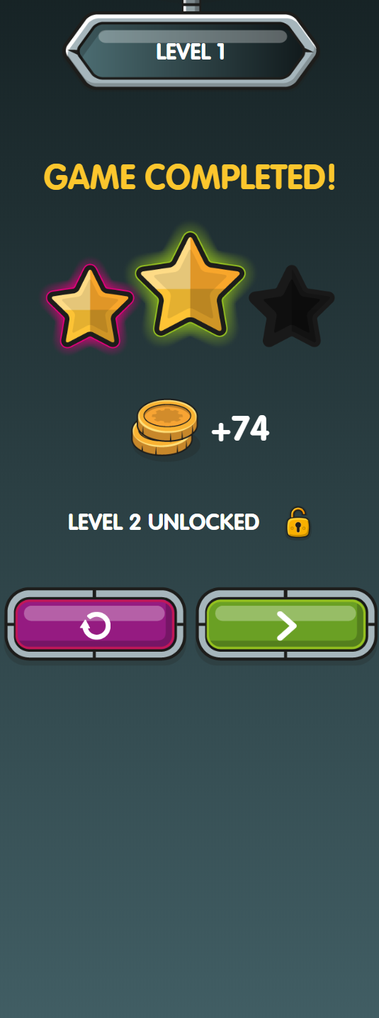
At the end of the level you will see how many stars you earn.
[Menu]
Earn 2 or 3 stars to unlock the level.
Have another go.
Notes:
The purple button means “have another go” or “repeat the level”. You need to earn at least 2 stars to unlock the next level.

Slide 41
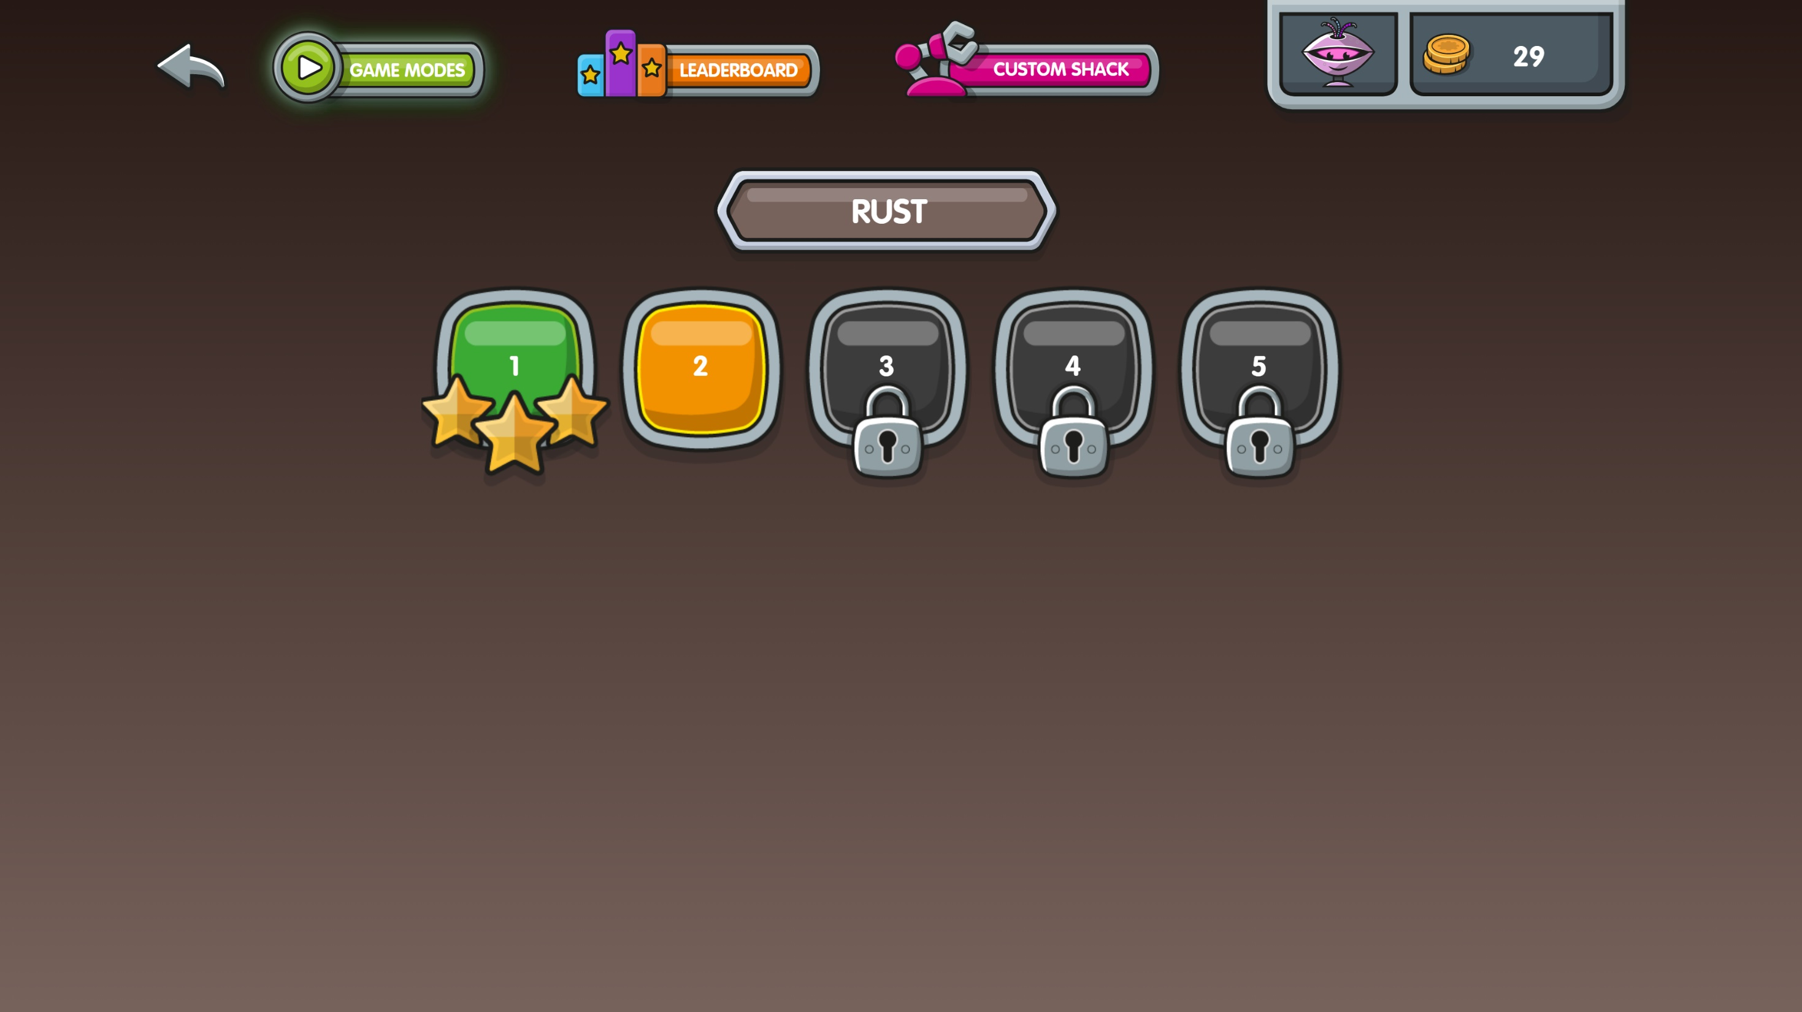
[Menu]
I play level 2.
Why is level 3 not unlocked?
Level 2 is now unlocked.
Notes:
Feel free to skip this slide if you want to save time.
Level 3 is still locked because I only earned 1 star.

Slide 42
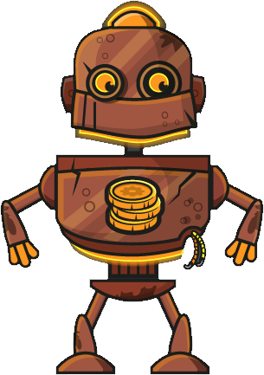
[Menu]
In every Stage, you earn parts to upgrade Rusty.
Iron
Tin
Copper
Notes:
Here are examples of the parts that players unlock in the first three stages.
Feel free to skip this slide if you want to save time.

Slide 43
[Menu]
20 levels
Correctly answer as many as you can
Different skills
Correctly answering 12 questions unlocks next level
60 seconds
Notes:
Challenge mode is about speedy correct answers on different skills.
Remember, Challenge mode is locked to start with and can only be unlocked by getting to a certain point in Story mode.
You start in Challenge level 1. To unlock the next level, you need to correctly answer 12 questions in a minute.
Each time you play a Challenge level it lasts 60 seconds. The objective is to correctly answer as many as you can.

Slide 44
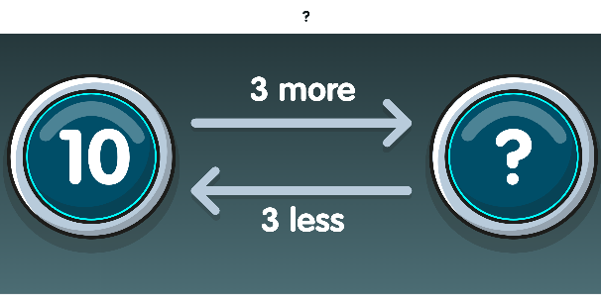
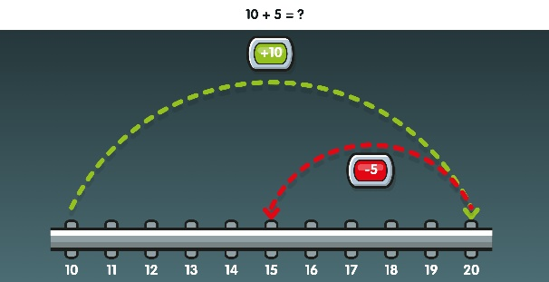
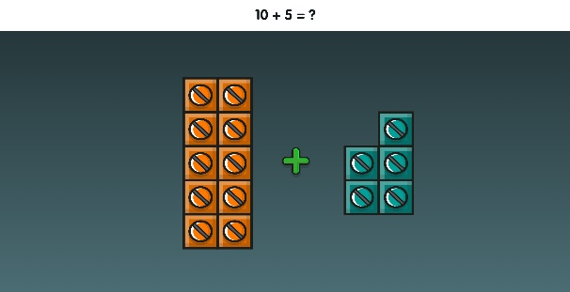
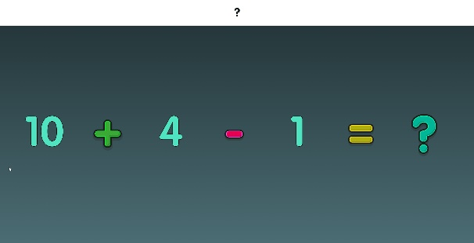
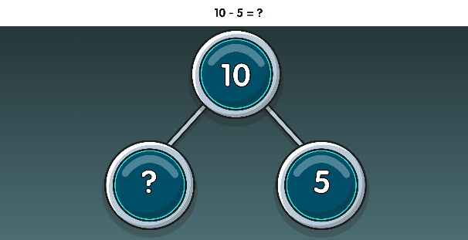
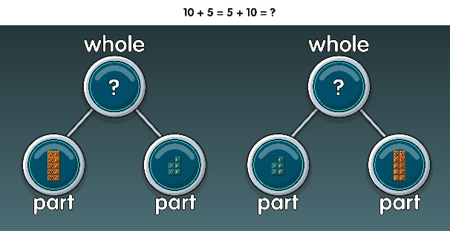
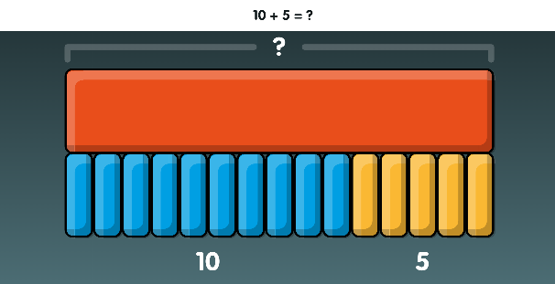
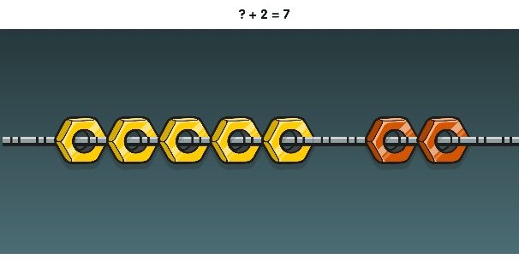
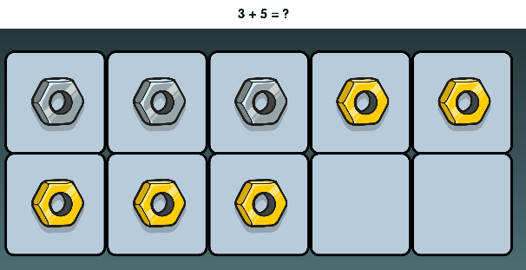
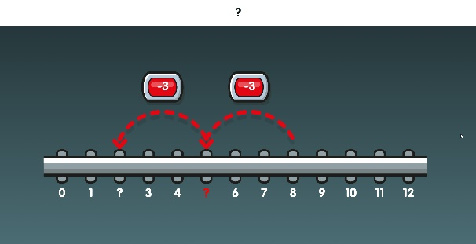
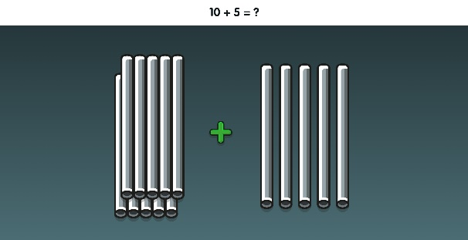
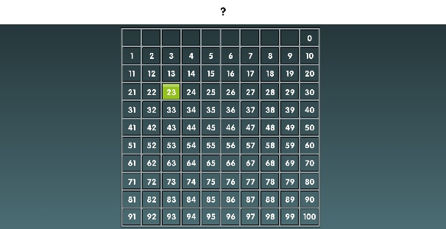
[Menu]
ADDING & SUBTRACTING
Learning Intentions
NUMBER BONDS
COUNTING
100
Notes:
The three core strands of NumBots are subitising (“counting without counting”), number bonds and addition & subtraction.
Here are some screenshots of the representations we use.

Slide 45
Times Tables Rockstars is a great Maths website which can be used in conjunction with Numbots.
The children will have the same password and can begin to access the times tables applicable to their year group.
More about this in Key stage 2…

Slide 46
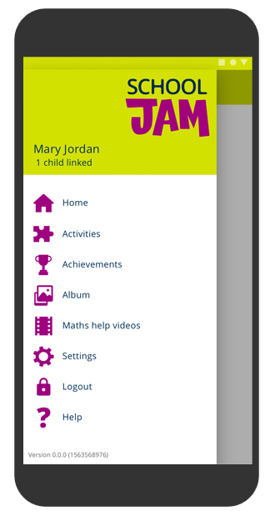
Engaging with your child’s learning through fun activities!

Slide 47
What is School Jam?
It’s an app for parents through which your child’s teacher sends you a weekly maths activity to try with your child, linked to what they are learning in school.
It includes maths help videos especially written for you, so that you can support your child with maths.
School Jam is fun for you and your child to do together!

Slide 48
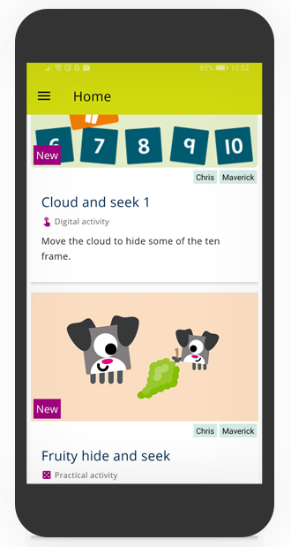
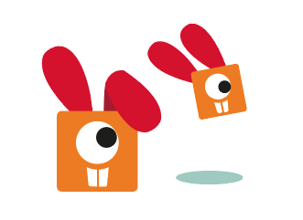
All of the short, fun activities are designed for you and your child to do together.

Slide 49
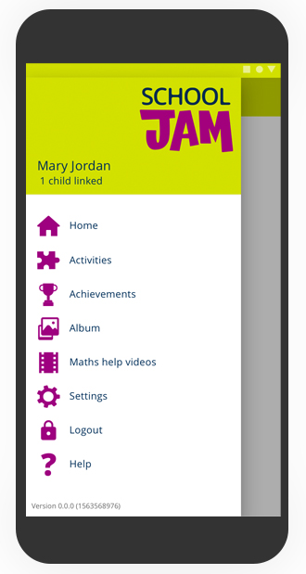
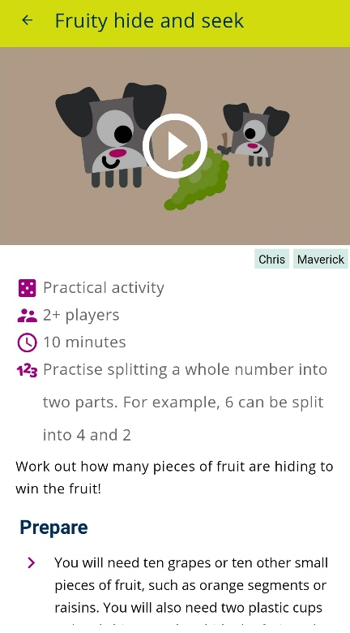
Activities are either practical …
Practical activities have either a fun demo video or clear images to help explain how to do the activity.
Activities might require you to gather simple items from around the home, such as paper or toys.

Slide 50
All practical activities have a ‘take it further’ element if you want to give your children more of a challenge.
You can use the School Jam app to tell your child’s teacher when you’ve done the activity.

Slide 51
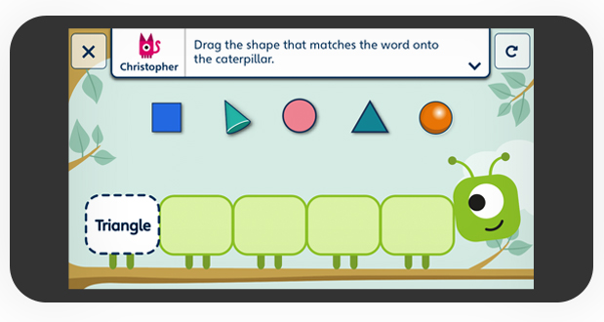
… or digital.
In this example, you work together to match the shapes to the words on the caterpillar.

Slide 52
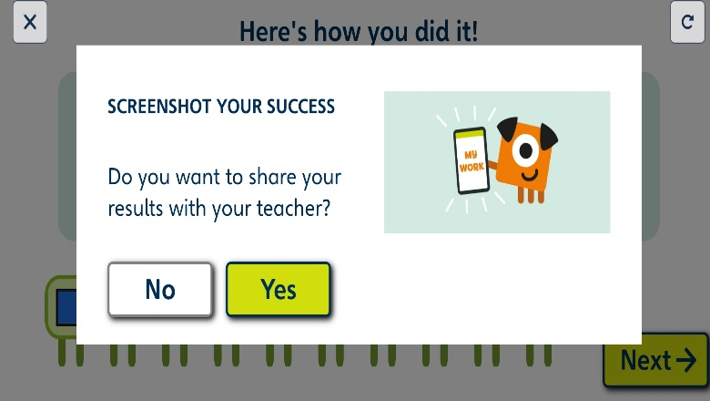
You can send a screenshot of your work to the teacher when you’ve completed the activity.
Your teacher might use these as a lesson starter, or to prompt a maths discussion in class.

Slide 53
Celebrate your achievements
Collect trophies as you and your child complete the activities.

Slide 54
You can also watch maths help videos.
These short videos explain maths methods and support what your child is learning in class.

Slide 55
How to get started!
Download School Jam for free from the App store or Google Play.
Look out for your child’s code in their book bag.
Fill in your details and your child code on the app – then get ready to do some fun activities!

Slide 56
Other useful websites include the following:
https://www.bbc.co.uk/cbeebies/joinin/numberblocks-help-your-child-with-maths
https://www.oxfordowl.co.uk/for-home/maths#

Slide 57
Before you leave…
A Key Stage 1 Maths puzzle for you to solve.
Noah saw 12 legs walk by into the ark. How many creatures could he have seen? How many different answers can you find? Can you explain how you found out these answers?

Slide 58
Thank you for attending tonight; I hope it has been useful!
If you have any questions, please pop up and see me.
The Powerpoint will be uploaded onto the Elburton website and don’t forget… MATHS IS FUN!
Inspiring today’s children for tomorrow’s world

