Slide 1
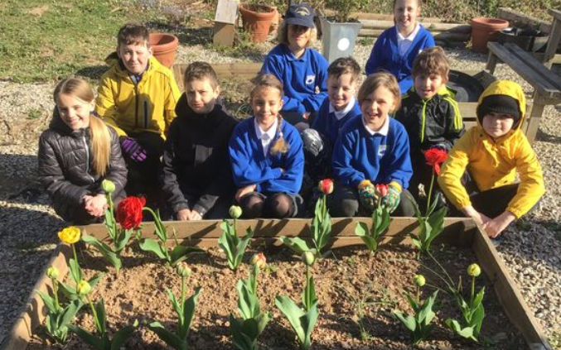
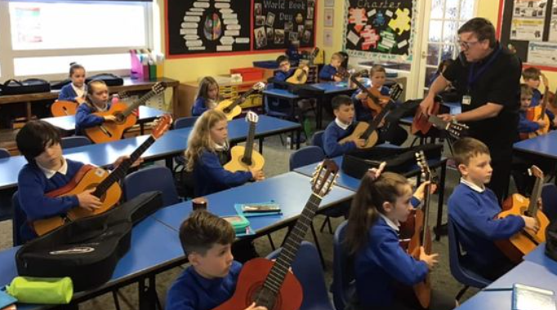
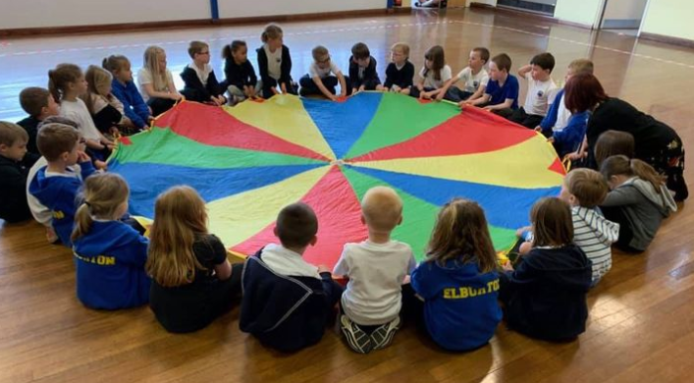
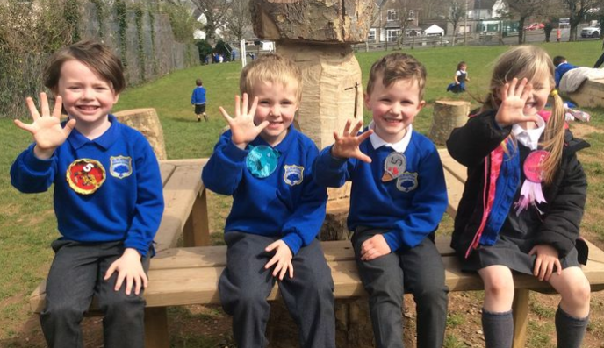
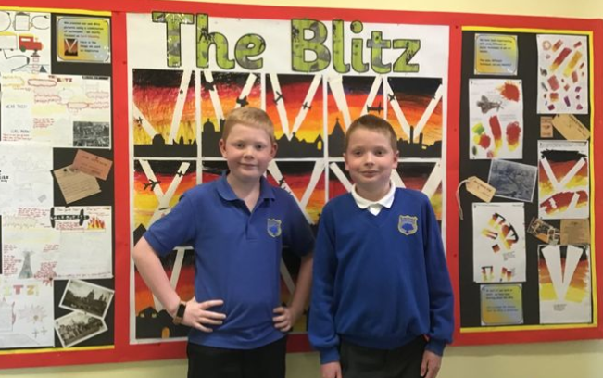

Elburton Primary School
SEN Information Report
(Updated June 2022)

Slide 2
What is SEND?
A child or young person has a SEND if they have a learning difficulty or disability which calls for special educational provision to be made for him or her (6.15 CoP).
A child of compulsory school age or a young person has a learning difficulty or disability if he or she:
Has a significantly greater difficulty in learning than the majority of others of the same age or
Has a disability which prevents or hinders him or her from making use of facilities of a kind generally provided for others of the same age in mainstream schools or mainstream post-16 institutions (Children & Families Act, Part 3, section 20)

Slide 3
…What is send?
We are an inclusive school, aiming to support all children and their individual needs within the limitations of our school budget.
The Code of Practice 2015 identifies 4 broad areas of need:
1. Communication and interaction
2. Cognition and learning
3. Social, emotional and mental health difficulties
4. Sensory and/or physical needs
Children who have English as an Additional Language are not regarded as having a learning difference if the only difficulties are language barriers.
Health conditions and/or physical disabilities which require special educational provision to be made will be covered by this SEND definition.

Slide 4
How does Elburton support children with SEND?
Independence
High Quality Teaching
Varied teaching approaches
Child
Small group work/targeted interventions
Adaptions to school environment (where possible)
Differentiated work and support

Slide 5
Wherever possible, the teaching and learning environment is tailored to meet the needs of all children. In addition to this we have a progression of steps in order to support children who have, or may have SEND.
High Quality Teaching – differentiated as necessary
Small group support, either in class or as part of a targeted intervention
Specialist support within school within the school e.g. ELSA (Emotional Literacy Support Assistant)
Referral to an outside agency for specific assessment, support or advice

Slide 6
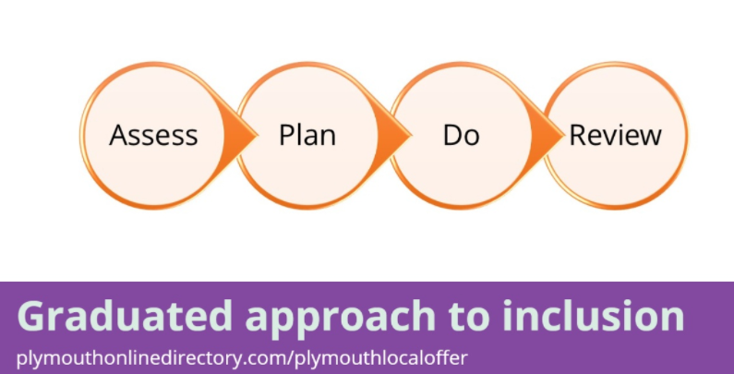
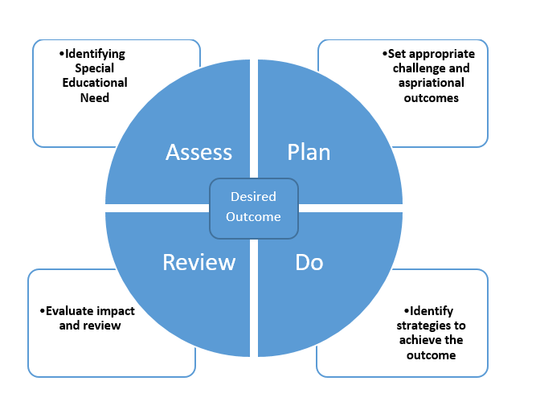
Graduated Approach
The school follows the graduated approach to inclusion and an assess, plan, do review cycle to help target the support a child requires.

Slide 7
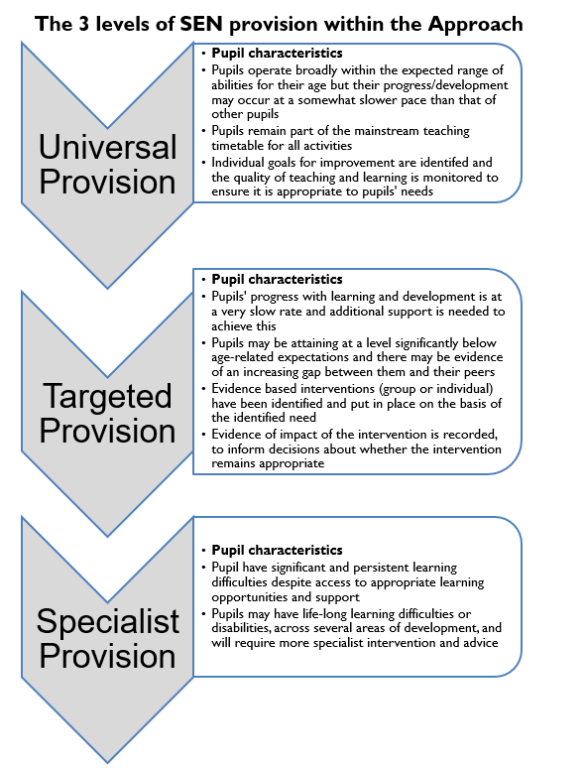
At Elburton Primary School the majority of pupil’s needs will be meet through universal provision.
Should a child be identified as needing targeted provision, their needs will be discussed with the SENCO at termly meetings, as well as communicated to parents through and open door policy and parents evenings.

Slide 8
What will happen if my child does not make expected progress or is identified as needing more support?
Each class teacher will assess the children continually, as part of their everyday teaching. If they feel a child is not making expected progress they will try different approaches and styles to help them to learn. This will then be discussed with the Special Needs Co-Ordinator at a Termly Pupil Progress Meeting and next steps recorded.
If more or different support is needed, targeted provision will be put in to place to support the child to help them to make more progress. This is discussed with parents via Parents evenings and our open door policy. This is monitored through SEND Review meetings with the SENCO and class teacher.
Sometimes, the school’s SENCO will offer advice on their particular difficulty and appropriate support/resources recommended. Screening tools may also support this.
If necessary the SENCO will seek advice from other professionals to make more detailed assessments. (See SEND Policy) An IEP may be needed at this point, to support the delivery of specialist advice and measure impact.
If a multi-agency response is required, targets may be documented through a Multi Agency Support Plan (MASP/TAM) or an Early Help Assessment Tool (EHAT). This helps co-ordinated the advice from multiple agencies.

Slide 9
How accessible is Elburton?
Elburton currently has 467 pupils on role, including Stepping Stones Pre-school. All classrooms are housed within one main building, which is on 3 levels. There are steps up and down to access the areas.
All classrooms can be accessed from the outside via slopes, should disabled access be required. The two year 6 classroom can be accessed by an internal ramp if required.
There are 3 playgrounds, a large field and separate trim trail climbing playground. 1 of the playgrounds has a trim trail with soft flooring. There is a set of steps to access the Jubilee playground, but it is possible to reach this via a slope. The remaining playgrounds are reached via slopes. The following slide shows a plan of our school.
Further information can be found in our Disability Equality Scheme & Accessibility Plan

Slide 10
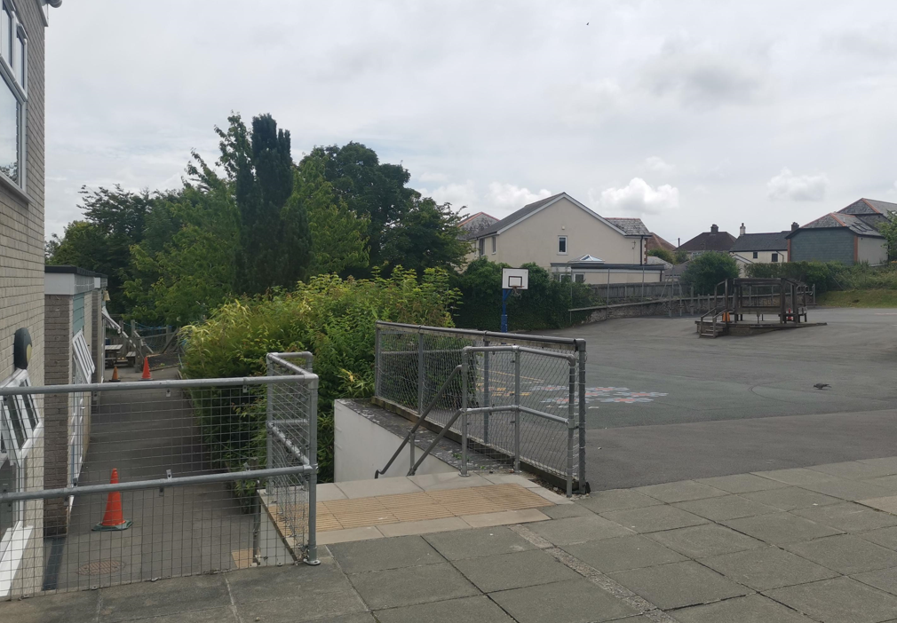
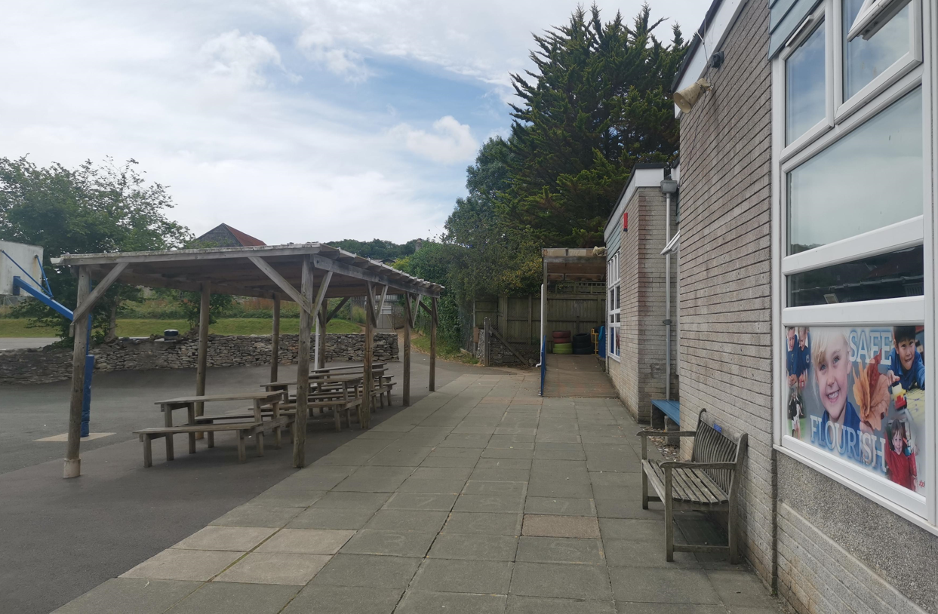
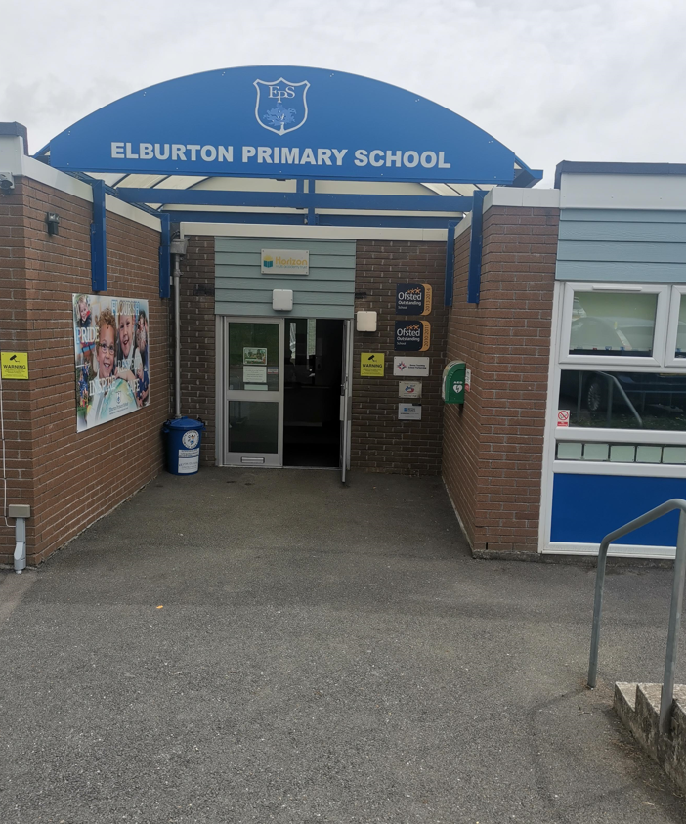
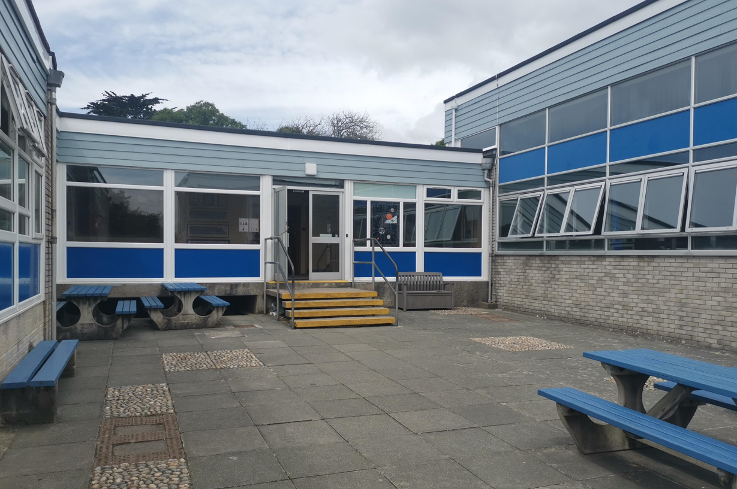
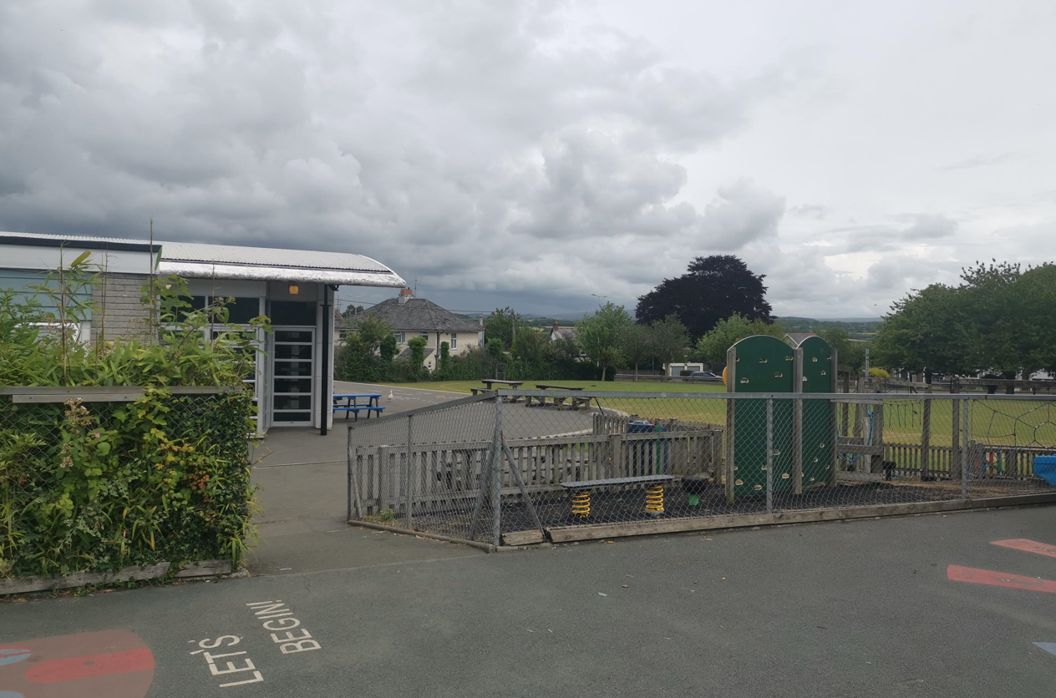

Slide 11
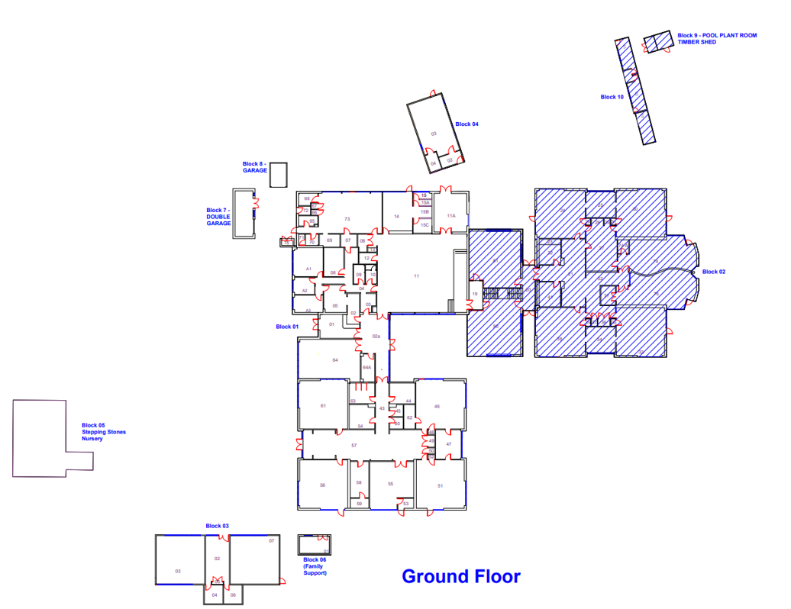
MAP

Slide 12
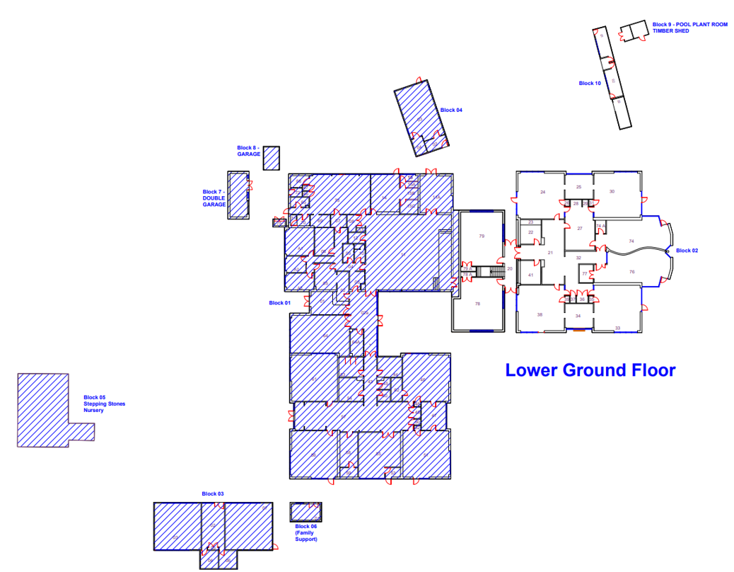

Slide 13
Where can I find information about Elburton’s approach to pupils with SEND?
Our school website has lots of information about the school. There is a designated area for SEND, where you can find a copy of the SEND Policy, as well as a link to the Plymouth Online Directory (POD), which has a wealth of useful links.
The SEND web page also has other useful weblinks for parents of children with SEND.
Alternatively, you are welcome to contact Mrs Birnie, our school SENCO or Mr Smithers, our Headteacher, who will gladly discuss any issues with you.

Slide 14
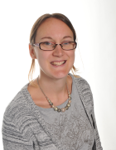
Who is the person responsible for children with SEND?
Mrs Birnie is our school SENCO. This stands for Special Educational Needs Co-ordinator. She co-ordinates the provision for our SEND children across the school.
Each class teacher is responsible for the day to day teaching of SEND children in their class. The headteacher has overall responsibility for all pupils.
All of the staff within the school work in partnership with Mrs Birnie to meet the needs of our SEND children.

Slide 15
How do I contact the people responsible for SEND or arrange to meet them?
Mrs Birnie can be contacted:
1. By Writing:
Elburton Primary School
Haye Road South
Plymstock
Plymouth
Devon
PL9 8HJ
2. By Telephone: 01752 404489
By email: lbirnie@elburton.Plymouth.sch.uk

Slide 16
What training or specialist expertise do the Elburton Staff have around SENd?
Mrs Birnie has achieved the National SENCO Qualification.
Mrs Causon, Mrs Clarke and Mrs Twaits have completed the Emotional Literacy Support Assistant (ELSA) course.
The Foundation Team have been trained in the use of Cued Articulation to support speech and language development
All teaching assistants have taken part in Precision Teaching and Colourful Semantics training
Lisa Clarke (Pastoral Lead) has been trained in a variety of specialist CPD
All of the teachers and teaching assistants have taken part in In Service Training (INSET) about a range of different Special Educational Needs. There is also an ongoing professional development programme for staff, including Local and National updates.

Slide 17
What further external support can elburton access and when would this happen?
When a differentiated, targeted curriculum is no longer having an impact on a child’s progress or emotional well-being the SENCO may request further advice, support or assessment from the relevant outside agency. The school has access to the following services and more:
Speech and Language Team – NHS or PLP
Communication Interaction Team (CIT)
School Nurse
Multi Agency Support Team (MAST) including Family Support Workers and Educational Psychologist
Transition support from the local secondary schools
Social Services
Primary Mental Health Team
CAMHS
Adoption Support UK
Jeremiah’s Journey
Woodlands Outreach Team
Child Development Centre – via the GP
Occupational Therapy
Further information on these services can be found within the Plymouth online Directory
SEND Local Offer - Plymouth Online Directory

Slide 18
Who can I contact to provide additional advice and support for my family?
Lisa Clarke is available to support families in her role as Pastoral Lead. She is able to offer a range of support and impartial advice including:
Signposting parents to different organisations that may help them such as Plymouth Information Advice and Support for SEND (PIAS).
Listening and talking to parents about their anxieties or difficulties.
Providing support for parents to help them deal with parenting challenges such as behaviour, sleeping, eating, bereavement and other difficulties.
Depending on the issue, the class teachers, Headteacher, Assisstant Head and SENCO are also able to offer advice and support.
Parents can also access the Plymouth Online directory for further advice or support:
SEND Local Offer - Plymouth Online Directory

Slide 19
How does elburton involve parents and children in their SENd support?
At Elburton we operate an open door policy and value our strong relationships with parents and carers. We recognise the importance of working together to secure the best possible outcomes for all children. We also have regular parents meetings with class teachers, where parents can share and review targets, progress and support arrangements.
Children are actively encouraged to understand their targets and celebrate their success in achieving them and a ‘Person Centred Planning’ approach is taken.

Slide 20
Parent Testimonial
"The confidence is noticeable and the overall love of going to school, is the confirmation that Elburton was the right choice. The support given not only to my son but also us as a family, has enabled the SEND journey to be a little less scary and a little less lonely. Communication between school and home is so important. The approachable staff at Elburton have made it easier to talk about the strategies which work at home and could help in school, but also gain invaluable advice on what can be introduced at home that works in the classroom. Every SEND journey is an individual and Unique one, but Elburton Primary has encouraged a great start, a learning journey offering opportunity and inclusion"

Slide 21
Parent Testimonial
‘It takes a village to raise a child’. This we all know is true. When we found Elburton School we found our village. Our child has extensive additional needs and requires a lot of extra support. Part of his disabilities means that currently he finds it incredibly hard to form words. How can you send a child to school who cannot verbalise? We were concerned to say the least. ‘He’s doing just fine’. This we were reassured of on our very first walk around with Mr Smithers.
Elburton has succeeded where others have failed, because they care a great deal about each and every one of the children in their care. Inclusion isn’t a buzz word, but a way of life. It’s raw, it’s real and they often make us emotional. In a good way of course!
Their open door policy is also, it would seem, an all hours policy. We have on many occasion kept a teacher way past their home time or had a response to a message in the evening when you could expect that they are off duty. Support is there when you need it.
They go above and beyond to tailor our child’s learning journey to support him best. Their can do attitude means that our child is growing in confidence every day. He has a very long way to go, this is true, but we have every faith in the incredible team at Elburton.
Before starting at the school we had hoped that he could make a friend. He has so many and really enjoys coming to school. To be completely honest we have to forewarn of upcoming holidays as school is his favourite place to be. He’s happy and when a child is happy and supported, they can achieve their full potential. There will be hurdles that need jumping along the way, but he has a lot of people cheering him on.
Elburton school is a wonderful community and one that we are proud to be a part of. We will forever be incredibly in their debt.

Slide 22
Where can I find information about the Local Authority’s local offer for children and young people with SEN and their families?
The Local Authority’s Local Offer can be found at:
SEND Local Offer - Plymouth Online Directory
This contains a directory of services available to parents and children and provides information about SEN support and provision in Plymouth.
For any other information about our school and the opportunities we offer, please refer to our website, prospectus or contact the school office on 01752 404489

Slide 23
What happens at different transition points?
The school works closely with parents, Stepping Stones and local Pre-schools to ensure quality transition into school, for pupils with SEND. This is to ensure successful strategies can continue within a new setting, as well as communication of needs and support required. When a transition is successful the child feels prepared and heard.
The school adheres to the Local Authorities Transition Programme using the appropriate paperwork and transition codes.
The transition process to Secondary School for children with SEND, begins in Year 5. Parents will be involved in the process of an enhanced transition, through TAM meetings and visits to the Secondary School.
Throughout Year 6 children with SEND are provided with a gradual, planned transition. Those needing it will have this enhanced transition to familiarise themselves with the new setting and staff. In this way a thorough exchange of information about the child will take place and they will be supported from both staff at Elburton and the receiving school.

Slide 24
If I am not happy with the provision at Elburton, how can I share my concerns or make a complaint?
We very much hope that you will be happy with the provision for children with SEND at Elburton. However, if you are not happy with the provision in place for your child, there are several ways to resolve this:
Talk to the class teacher
Talk to the SENCO
Talk to the Headteacher/Assistant Headteacher
Contact Plymouth Information Advice and Support for SEND who offer impartial support and advice.

Slide 25
Glossary
CAMHS – Child Adolescent Mental Health Support
CDC – Child Development Centre
CIT – Communication Interaction Team
EHAT – Early Help Assessment Tool
ELSA – Emotional Literacy Support Assistant
EP – Educational Psychologist
IEP – Individual Education Plan
MASP – Multi Agency Support Plan
MAST – Multi Agency Support Team
PIAS – Plymouth Information Advice and Support
POD – Plymouth Online Directory
TAM – Team Around Me meeting
SENCO – Special Educational Needs Co-Ordinator
SEND – Special Educational Needs and Disabilities

