Slide 1
Number Bond Rhymes
to Ten
Activity ©Bev Evans, 2012 www.communication4all.co.uk

Slide 2
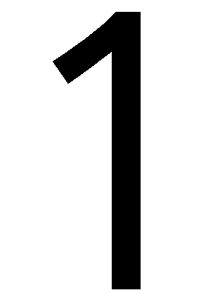
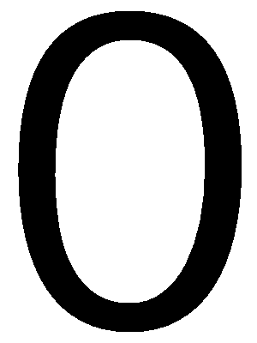
Number Bond Rhymes
to Ten
Click to see the rhyme
Zero and ten
Eggs again!

Slide 3
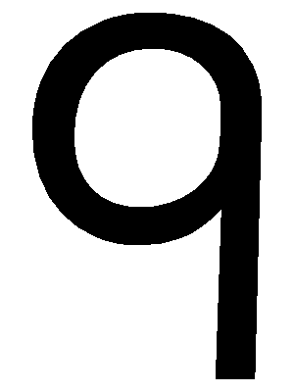
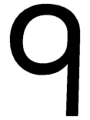
Number Bond Rhymes
to Ten
Click to see the rhyme
Nine and one
Ballooning fun!

Slide 4
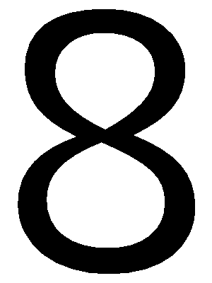
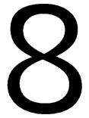
Number Bond Rhymes
to Ten
Click to see the rhyme
Two and eight
Love to skate!

Slide 5
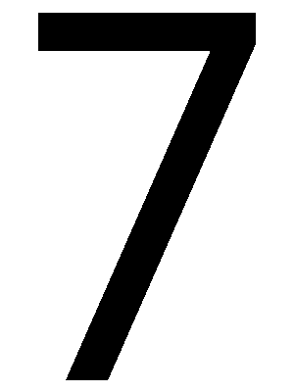
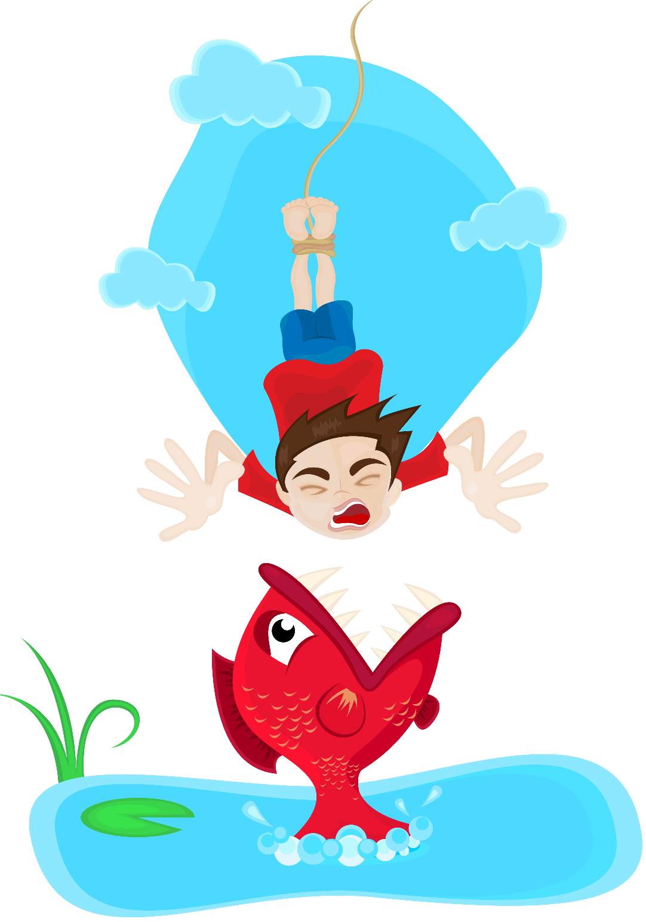
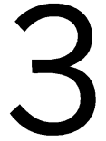
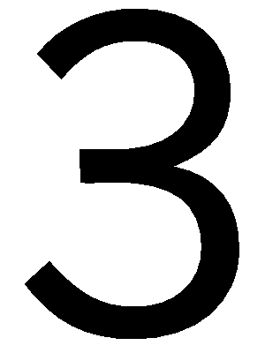
Number Bond Rhymes
to Ten
Click to see the rhyme
Seven and three
Love to bungee!

Slide 6
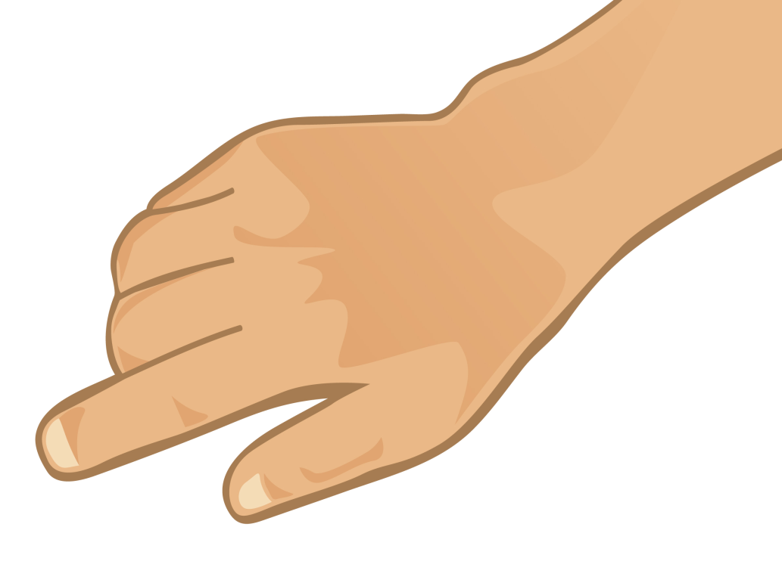
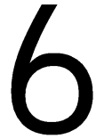
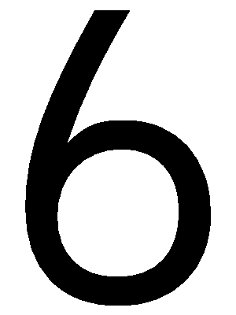
Number Bond Rhymes
to Ten
Click to see the rhyme
Four and six
Yo-yo tricks!

Slide 7
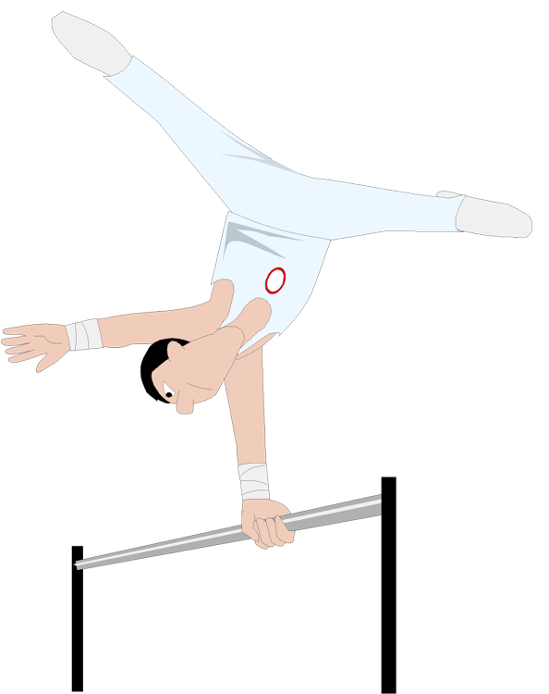
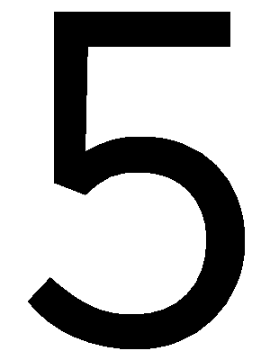
Number Bond Rhymes
to Ten
Click to see the rhyme
Five and five
Gymnastic jive!

Slide 8
Number Bond Rhymes
to Ten
Quit
Activity ©Bev Evans, 2012 www.communication4all.co.uk

