Slide 1
Welcome to ‘Getting To Know Year 1’ 2022-23
Inspiring today’s children for tomorrow’s world

Slide 2
The Year 1
Team

Slide 3
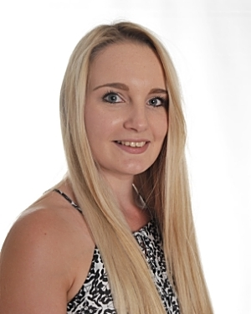
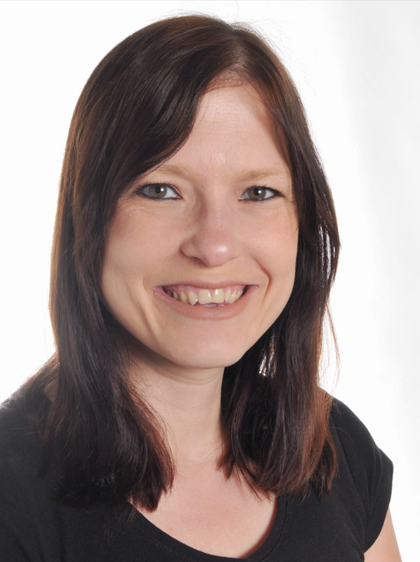
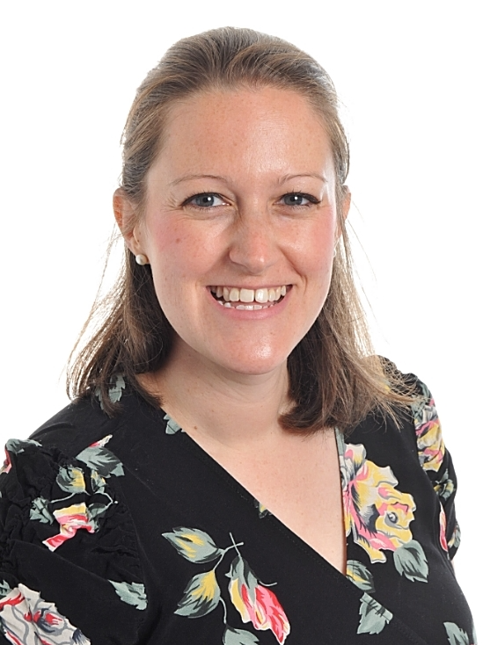
The Year 1 Team
Miss Collinson Birch Class Monday - Thursday
Mrs Phillips
Birch Class Friday
Mrs Johnson
Beech Class

Slide 4
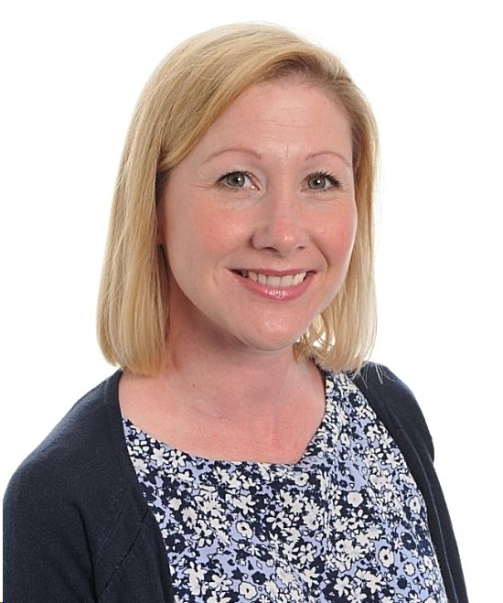
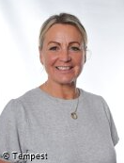
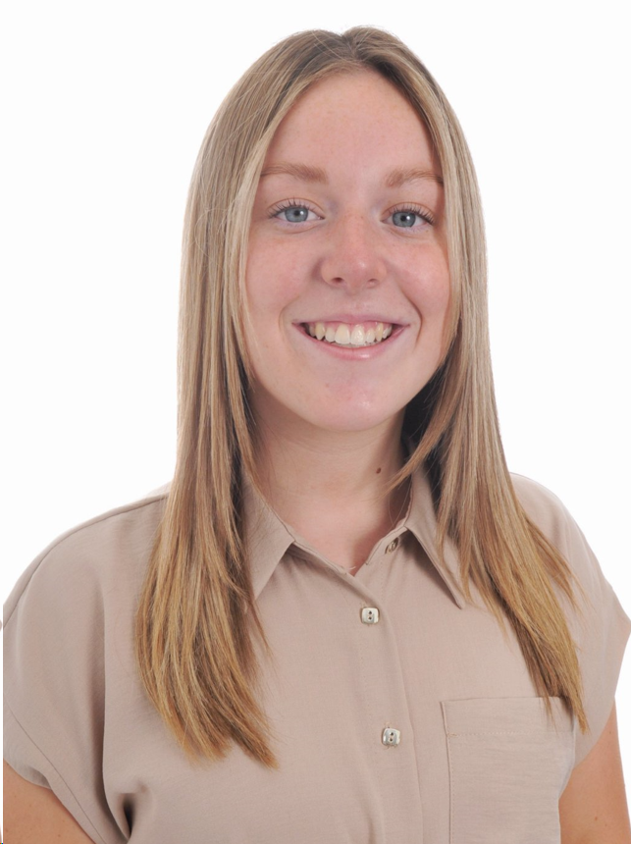
The Year 1 Team
Mrs Smith
Higher Teaching and Learning Assistant
Mrs Couling
Teaching and Learning Assistant
Miss Player
Apprentice Teaching and Learning Assistant

Slide 5
Useful Information
PE days: Monday/ Tuesday (indoor) and Thursday (outdoor).
Please read with your child every day – story time at this age is so important in developing your child’s love of reading, vocabulary and imagination. Children have access to a ‘reading for pleasure’ book, a Read Write Inc book bag and a Read Write Inc Oxford Owl ebook and quiz.
Reading books need to be returned to school every Thursday. This includes both the ‘reading for pleasure’ book and the Read Write Inc book. There is an expectation that the RWI books are read three times before they are changed. New books will be sent out every Friday. Please ensure that your child brings their reading diary and book into school every day.
Letters from the school will go home via Parent Pay. Class updates will be sent via Class Dojo. You view these messages on the class story.
We encourage the children to share their achievements with the class/ school as whole. This can be done via your child’s Class Dojo portfolio. If your child would like to share their achievements in our whole school Monday assembly, they can bring their certificates or medals in.
If you would like to speak to your child’s teacher, you can contact us on Class Dojo. All messages sent are private. We will do our best to respond as soon as possible.

Slide 6
Dojo Points
Year 1 do not access Tapestry. As a school, we use Class Dojo to recognise and reward positive learning behaviours and to celebrate our pupils’ success. This is an exciting way of earning rewards linked to our school drivers.
Once you are linked to your child’s account, you can see their avatar and share their success with them at home. Each term, the children can work towards earning Dojos that contribute to rewards and recognition for their efforts and hard work.
25 dojos they will receive a certificate,
50 dojos can be spent on a gift from the ‘Dojo treasure box,’
100 dojos - they will be rewarded for their outstanding efforts with a book.

Slide 7
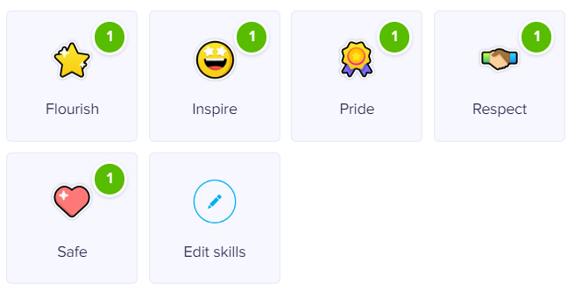
Our school aims to help children to ..

Slide 8
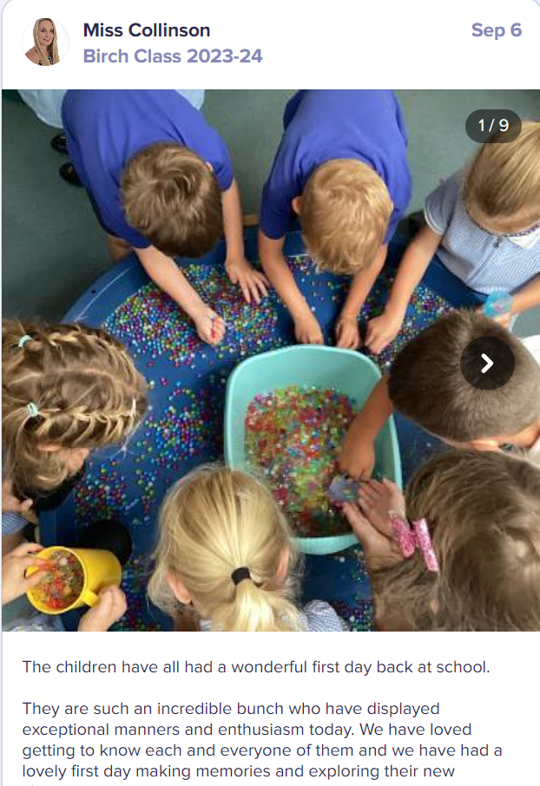
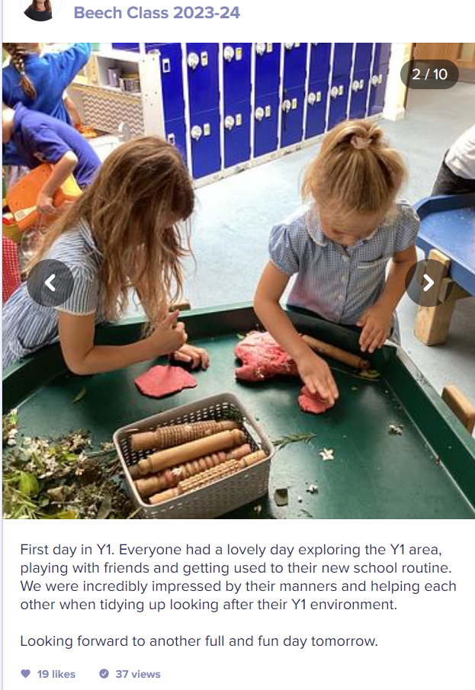
Our Dojo Class Story page

Slide 9
PSHE and growth mindset focus
In our school, we choose to deliver Personal, Social, Health, Economic Education using ‘Jigsaw’ - the mindful approach to PSHE.
Jigsaw brings together PSHE Education, emotional literacy, social skills and spiritual development in a comprehensive scheme of learning.
Your child may come home discussing issues which affect us all. We encourage discussion and openness in these situations in order to promote children’s good mental health and well-being.

Slide 10
The Year 1 Curriculum
Please find information about our curriculum this term on our class website page.
We aim to give our children a broad and balanced curriculum with lots of different learning opportunities.

Slide 11
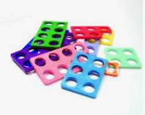
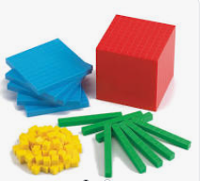
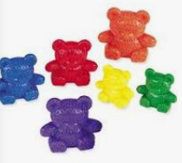
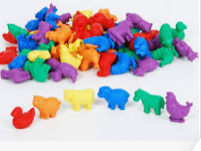
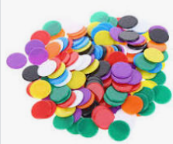
Mathematics
Maths objectives are based on the National Curriculum.
We follow the White Rose Scheme for maths where the children learn through a series of small steps which build to consolidate their understanding. These lessons are grouped into blocks ranging in length from 1-5 weeks depending on content.
We have a ‘confident to be wrong’ approach to maths; it’s important for children to understand that they can learn from their mistakes.
We use lots of different representatives to help the children consolidate their understanding of number.

Slide 13
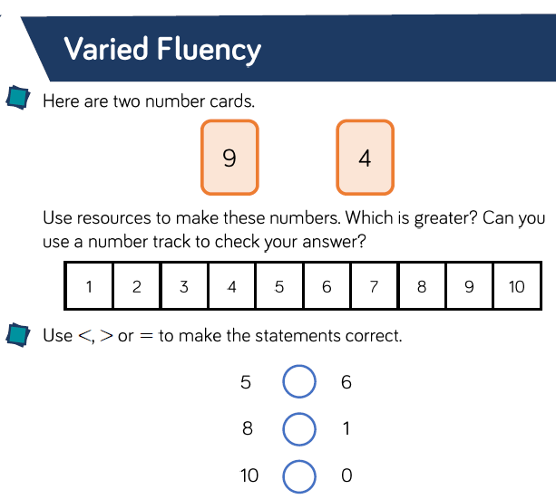
An example of independent learning in maths
Fluency work:
Problem Solving:

Slide 14
Reading
Your child is learning to read with Read Write Inc. Phonics, a very popular and successful literacy programme. Your child will learn to read in a very simple way.
He or she will learn to:
1. Read letters by their ‘sounds’
2. Blend these sounds into words
3. Read the words in a story
How will my child learn to read?
First, your child will learn to read:
Set 1 Speed Sounds: these are sounds written with one letter: m a s d t i n p g o c k u b f e l h r j v y w z x and sounds written with two letters • (your child will call these ‘special friends’): sh th ch qu ng nk ck
Words containing these sounds, by sound-blending,
e.g. m–a–t mat, c–a–t cat, g–o–t got, f–i–sh ﬁsh, s–p–o–t spot, b–e–s–t best, s–p–l–a–sh splash
Ditty Sheets, Red, Green and Purple Storybooks.
Second, he or she will learn to read:
Set 2 Speed Sounds: ay ee igh ow oo oo ar or air ir ou oy
Words containing these sounds
Pink, Orange and Yellow Storybooks.
Third, he or she will learn to read:
Set 3 Speed Sounds: ea oi a-e i-e o-e u-e aw are ur er ow ai oa ew ire ear ure
Words containing these sounds
Blue and Grey Storybooks.

Slide 15
Book marks will be given to your child as they progress through the RWI programme. These contain the ‘red words’ that are common exception words that are tricky to read and spell.

Slide 16
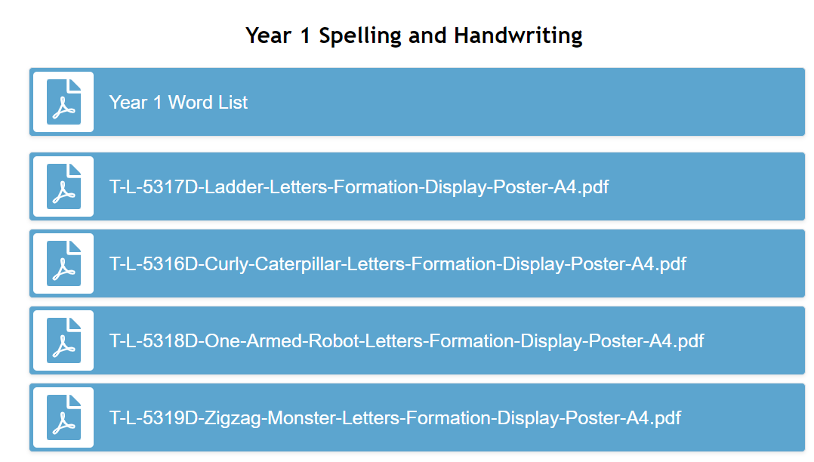
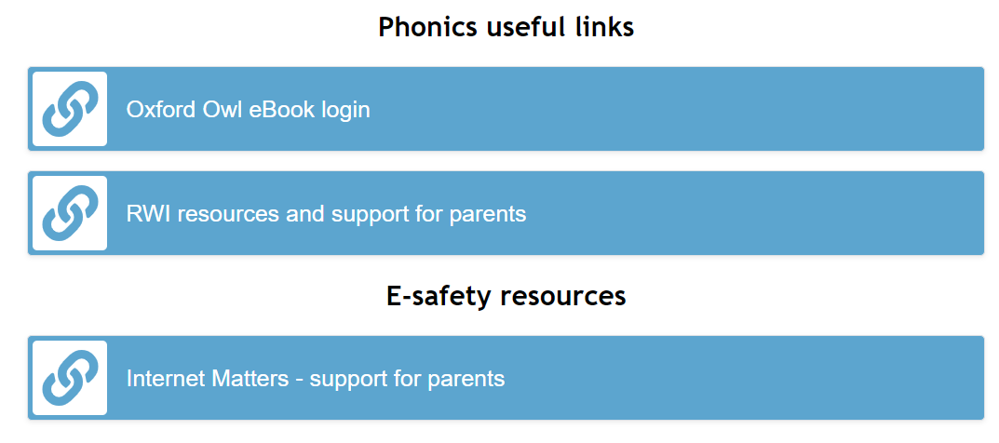
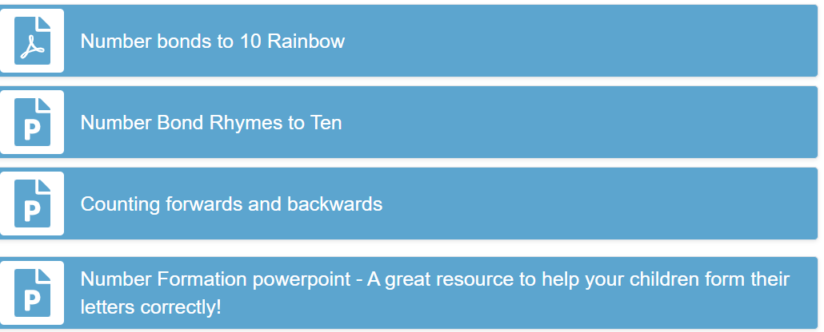
How to support your child at home
All of these resources can be found on our Year 1 website page. We are also more than happy to provide you with a paper copy at your request.

Slide 17
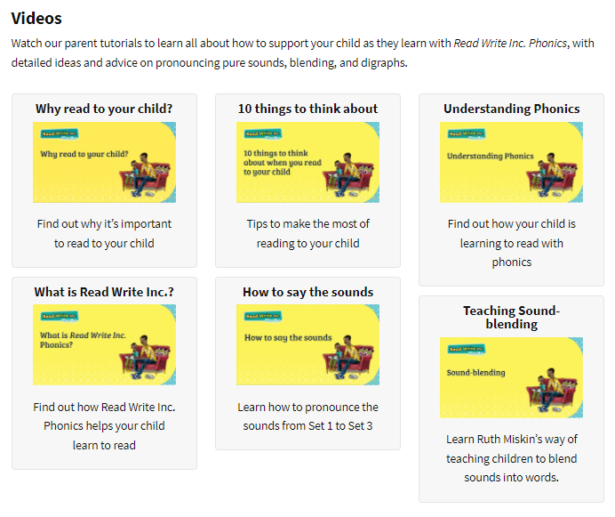
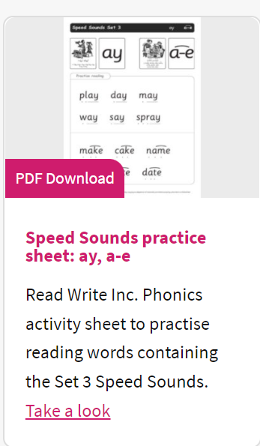
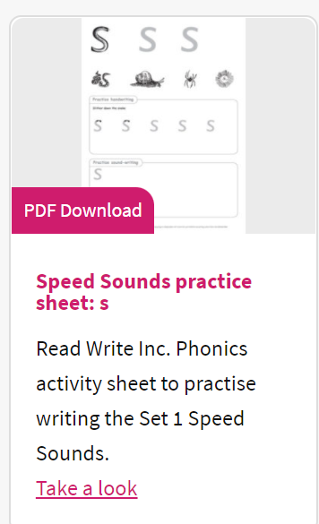
These videos are great at helping you to support your child with their reading journey at home. There are also free printables to help with reading specific sounds and forming specific letters.

Slide 18
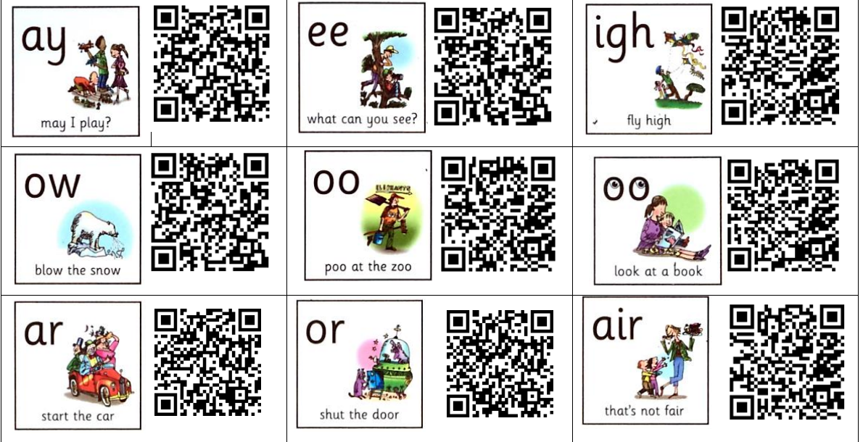
Read Write Inc home videos
Throughout the year, you will be sent QR codes that give you direct access to Read Write Inc teaching videos at home. These can be accessed by simply scanning the code on a phone or tablet. They are particularly useful if your child requires extra support with learning particular sounds.

Slide 19
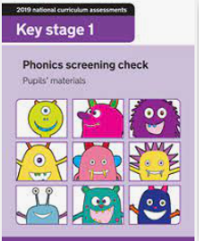
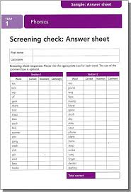
National phonics screening check
WB 10TH June 2024
We give the children an opportunity to become familiar with the assessment using past papers throughout the year. The children are unaware of being tested as this becomes part of our everyday practice. Parents will be informed about their child’s results when they receive their end of year school report but this will not be discussed with the children.
Screening is administered on a 1:1 basis.
The pass rate is usually 32 out of 40 but this can change.
If a child does not pass the screening in Year 1, they will retake in Year 2.
A meeting will be held at the end of May to discuss this in further detail.

Slide 20
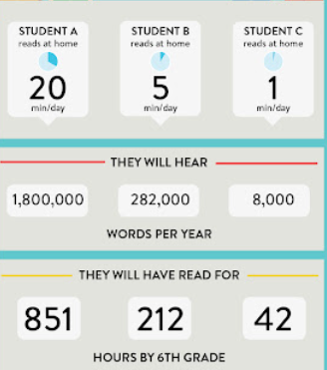
The importance of reading every day at home…
Hours by year 6

Slide 21
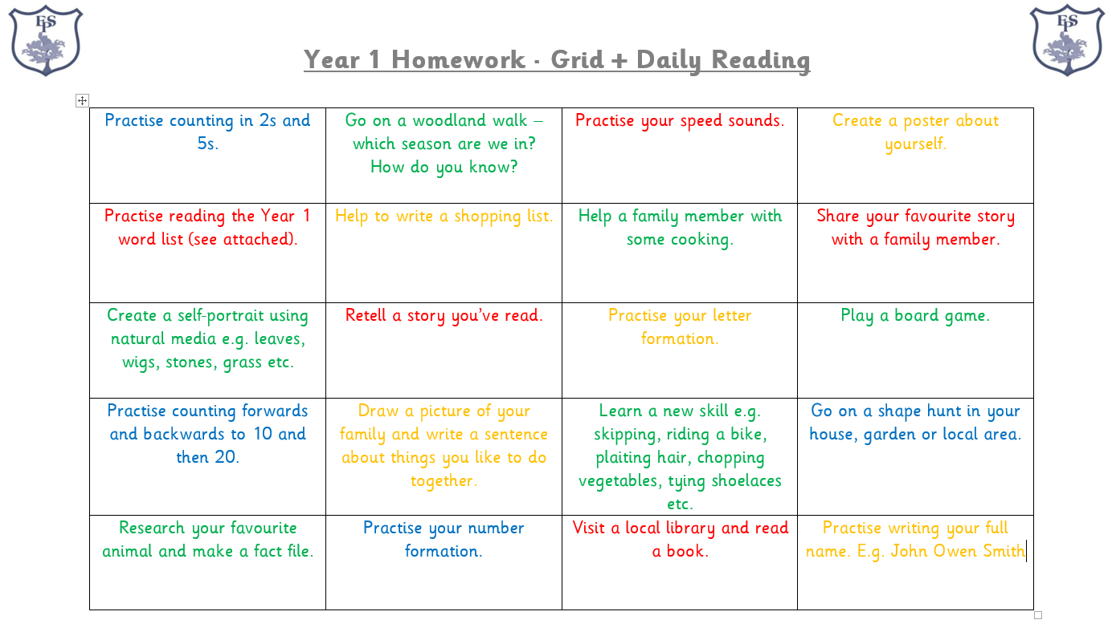
Home Learning 2023
Spelling Shed, Oxford Owl and NUMBOTS can be accessed at home. Your child’s login cards can be found in the back of their reading diaries.

Slide 22
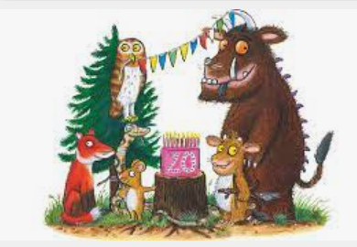
Writing
Through the year, we will cover a range of genres which are based around high quality texts that enrich the children’s vocabulary and knowledge of topics.
There will be a focus on pride in all written work throughout all subjects. By the end of year one, we expect the children to be able to independently write grammatically correct sentences that form a short narrative. They also need to be able to form all lower case and capital letters correctly.

Slide 23
Speaking and Listening
In school, we provide opportunities for the children to:
- Speak to different audiences (drama, role play, performance poetry and debate).
- Learning Partners will allow children to talk appropriately with different members of the class and will be changed regularly.
- Use appropriate vocabulary for different audiences and a high standard of Spoken English.
In order to consolidate their learning in school:
- Encourage your child to speak in full sentences.
Insist they show good speaking and listening habits by maintain eye contact and looking at the speaker.
-Provide lots of opportunities to engage in different conversations.

Slide 24
E-Safety
This is an important issue for children and adults.
There are some documents to support E-Safety on our school website.
If you should have any concerns about any inappropriate online content or behaviours, please do not hesitate to let us know.

Slide 25
We hope that you have found this information useful.
Please contact us via Class Dojo or come along to our ‘Meet the Teacher’ afternoon on Wednesday 20th September 3.15pm – 4.15pm.
Thank you for your continued support.
Inspiring today’s children for tomorrow’s world

